Slide 1
The My2N Management Platform
Streamline the management of 2N products via cloud

Slide 2
What is My2N?
My2N is a cloud management platform that makes the management of door communication and access control more efficient. It’s easy to use and accessible remotely.

Slide 3
How does My2N work?
Devices (intercoms, answering units and access readers) must be connected to the internet. The admin uploads users and devices to the site via the cloud platform and can configure calling and access rights for the building.

Slide 4
Make management of your 2N devices
Efficient
My2N automatically manages the setup for you, which means you don't need to know the SIP account or authentication proxy to set up the installation.
Cost effective
Save on travelling costs. Connect to the product remotely and handle 4 out of 5 of your customers' requests from your home or office.
Quick
Cloud setup for simple residential installations is up to 90% faster compared to traditional product-based configuration.

Slide 5
What can My2N Management Platform do?
Cloud Calling
Set up intercom calls over the internet
Access Control
Straightforward management of access rights
Remote Management
Manage the site and the devices from anywhere

Slide 6
Cloud Calling
Set up video calls from an intercom to a mobile phone or an answering unit installed in the apartment in just a few minutes.

Slide 7
99.98% reliability
No extra hidden HW
21st century services
Our statistics speak for themselves. Cloud calling via My2N is unquestionably the most reliable service you can offer.
We don’t over-complicate our solution with GSM gateways. You won’t even need to buy an answering unit for the intercom to enable video calling.
My2N offers video calling from an intercom to a mobile phone or tablet. Make sure you’re keeping up with modern demands for advanced services.

Slide 8
Cloud Calls in Retrofitted Installations
Not limited to only modern developments, cloud calling is also an ideal way to incorporate an IP door communication solution into an old building with insufficient (or even no) cabling.

Slide 9
Access Control
Manage user access rights in the intuitive My2N Management Platform environment.

Slide 10
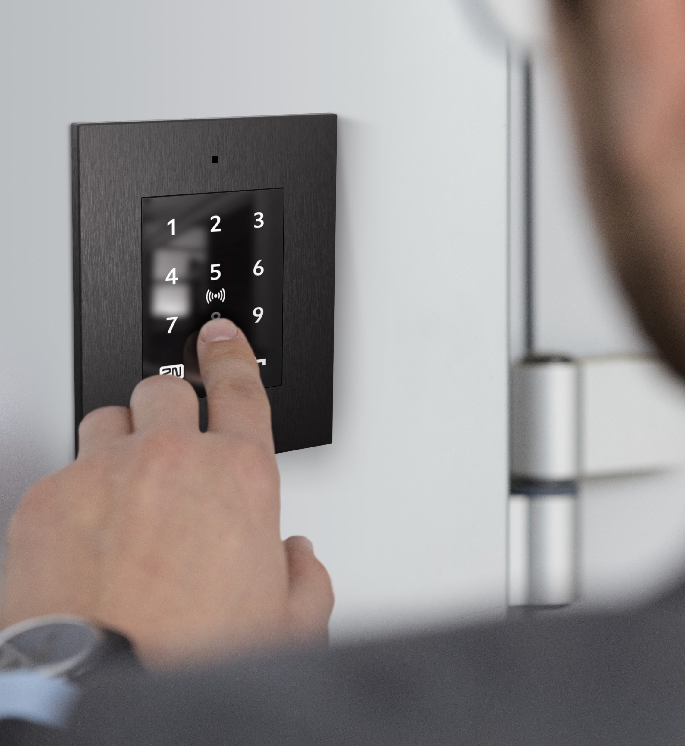
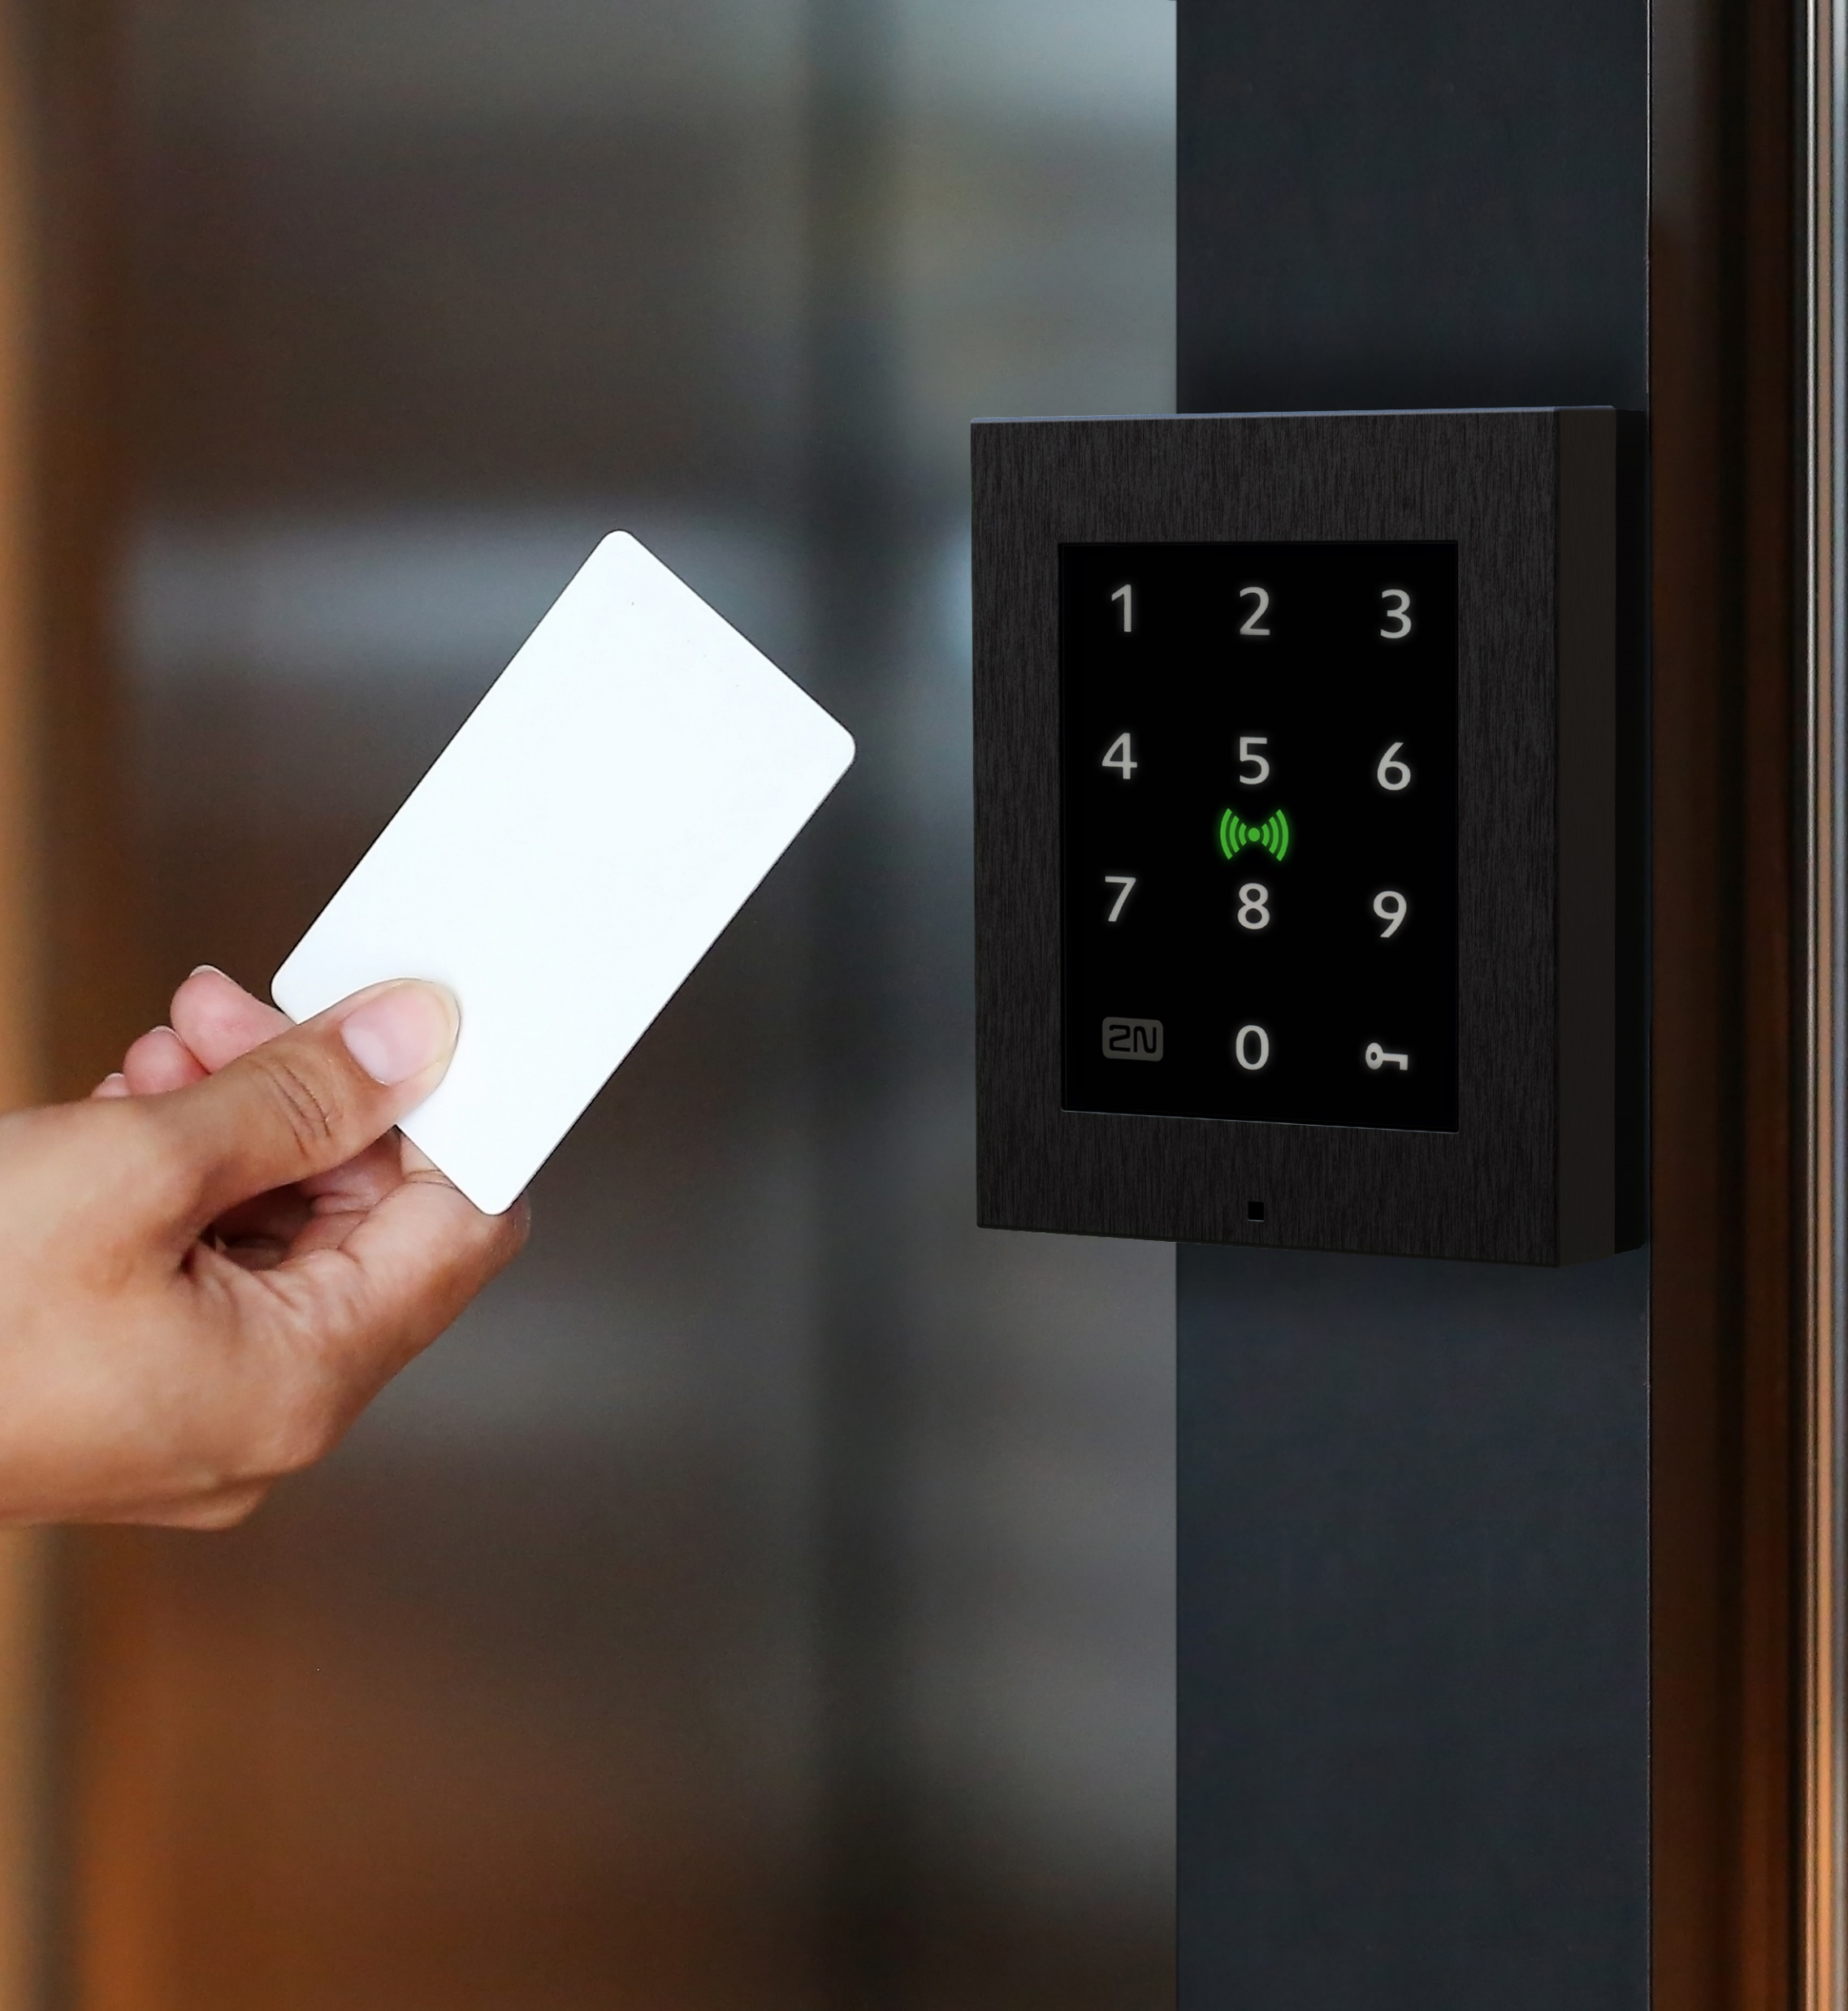
Apartment-driven access rights
Management of RFID and PIN code
Bulk assignment of access rights
Reduce the time spent managing access rights. Instead of setting them for individuals, set access rights for apartments.
You can set up two of the most popular access technologies on the residential market. Support for others is in the pipeline.
Don’t waste time assigning access rights to individual doors. Create access groups (a group of doors) and assigning an entire group to a user.

Slide 11
Remote Management
You can add and remove users, devices, update firmware, diagnose and troubleshoot from anywhere.

Slide 12
Happy customers
Offer a better SLA
Save on travel costs
Don't make customers wait days for you to get back to them. Respond to their requests promptly online.
The required response time to incidents in SLA is sometimes restricting. My2N allows you to offer terms that are unbeatable.
You don‘t need to spend time on the way to customer and waste money on fuel.

Slide 13
Security Overview
Hosting
International standards
Encryption
Our cloud solution offers security advantages like 24/7 intrusion & performance monitoring or instant deployment of the latest security updates.
The My2N cloud platform is designed in accordance with ISO/IEC 27001 and GDPR standards. We design, manufacture, and test all our products exclusively in the EU.
Our own protocol maintains permanent and secure connections between My2N cloud and 2N products: bringing immediate synchronization and secure calls.

Slide 14
Pricing
Core services (free)
Site management
User management
Product management
Firmware updates
Cloud calls between 2N products
Remote diagnostics and troubleshooting
Access data management
Provisioning (support for different firmware versions and networks)
Premium services (paid)
Cloud calling from an intercom to a mobile phone/tablet
Cloud calling from an intercom to another manufacturer's answering unit (also applies to the 2N® IP Handset and the 2N® IP Phone D7A)

Slide 15
Pricing (premium services)
Annual subscription per apartment:
36 EUR/40 USD (MSRP/WMP)
or
Annual subscription per device:
24 EUR/27 USD (MSRP/WMP)
More information: www.2n.com/products/the-my2n-management-platform/my2n-pricing

Slide 16
Get Started with My2N Today
Create a My2N account at my2n.com
Upload users and add 2N products
Get started with simple management

Slide 17
Make administration of 2N products efficient!

