Slide 1
#1 in IP intercoms

Slide 2
Open standards for integration
HD audio & video quality
Integrated Access Control
2N INTERCOMS PORTFOLIO

Slide 3
What differs us from the others
IP based products without any limitations
Easy integration thanks to open standards with a possibility for a vendor specific integrations
Saves your time and money
Makes your customer satisfied
Reliable and secure cloud services enabling calls to smartphone and remote configuration
Intercoms for any vertical with a possibility to choose even single modules
High quality products in terms of materials and reliable functionality
Notes:
Advantages of our technology:
Simple wiring reduces time spent on the installation site
Openness for the integration with 3rd party systems
Open standards and proprietary protocols
Compatible with more than 200 solutions
Extensive API
Most of our competitors have traditional, non IP solution with many limitations
New buildings are mostly based on IP - you will have to face it – better with professional solution
Scalability of the whole system – no dead ends
Trusted services generating money and saving time
Full range offer for MDU including also Access Control
IP technology
Shorter time spent on the installation site
- One type of cabling, simple wiring, sharing of infrastructure - maintained by non-electricals (IT guys), no need for deep wiring knowledge
- Plug & play solution with PoE – only a switch is needed, easy backup
IP - potential to improve – Audio & Video quality superior to 2Wire…..
No 2Wire issues (hum buzz, noise, security, privacy ….. )
No limits (number of units, video streams, distance)
No dead ends

Slide 4
INTEGRATION WITH 3RD PARTY PRODUCTS
SIP
Home automation
Video surveillance
HTTP API
Open standards and protocols
Vendor specific integration
Compatible with more than 200 solutions
Extensive API
ONVIF
RTSP/RTP
Physical security
Plugins
IP telephony
RIO
Wiegand
Property management
Notes:
Openness for the integration with 3rd party systems
We are using standardized protocols – you as SIs can benefit from…SIP, ONVIF, RTSP/RTP, HTTP API
Property Management (MDU) - need to be able to remotely manage installation (user management, billing per site or flat, concierge services, remote control of the unit, remote service, setup and maintenance)
Security (MDU, Villa) (video surveillance integration) use of cameras stream for answering units, intercom feed to VMS
Access Control (MDU) - remote management of credentials, temporary credentials (cradles access – biometry, Bluetooth, AirBnB like services, visitor management)
Home automation (MDU,Villa) companies - integration that is technically difficult, proprietary (protocols) and requires IP connection
In-home delivery - IP technology is best to integrate (IP camera for verification, http control of locks)
+ přidat ostatní oblasti integrace

Slide 5
VERTICALS
Residential
Office
Government
Education
Healthcare
Industry
Leisure & entertainment
Notes:
Tailored Intercoms addressing the needs of any Vertical

Slide 6
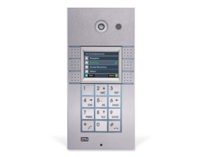
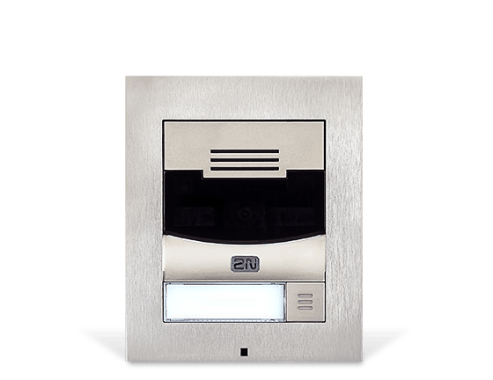
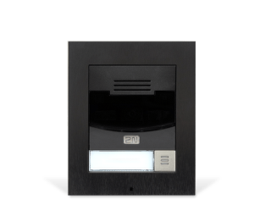
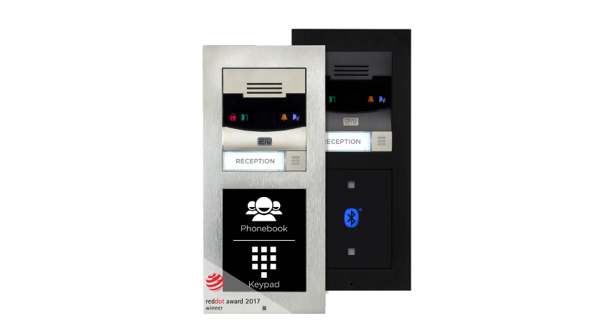
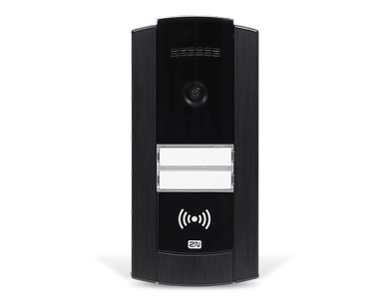
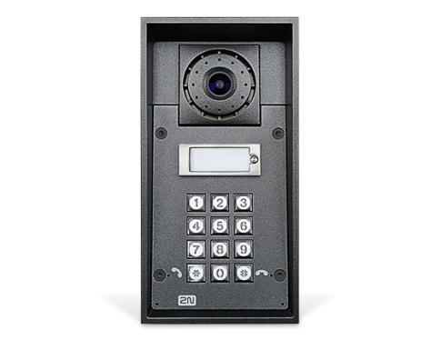
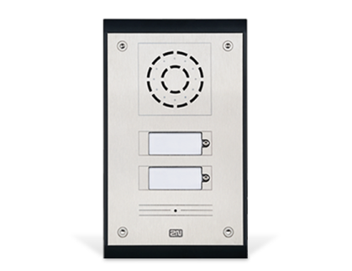
We´ve got an intercom for any type of a project
2N® LTE Verso
2N® IP Solo
2N® IP Verso
2N® IP Base
No cabling
Home automation
Modularity
Emergency
Compactness
Durability
Affordability
2N® IP Force
2N® IP Safety
2N® IP Uni

Slide 7
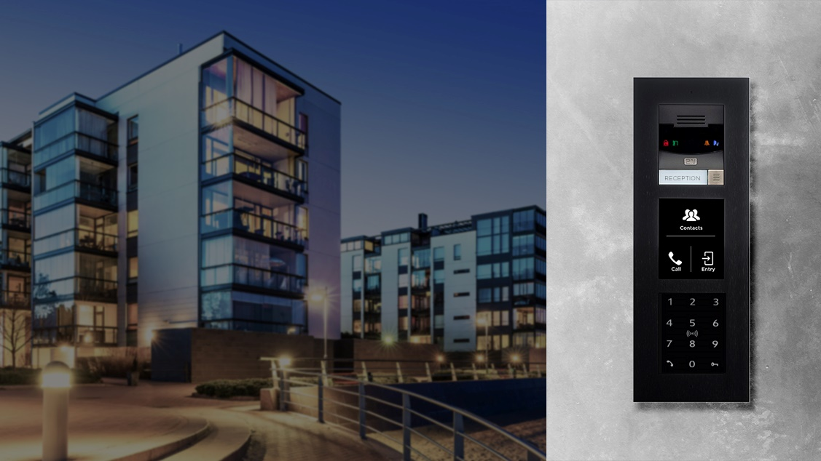
2N® IP VERSO
Luxurious modular
IP intercom

Slide 8
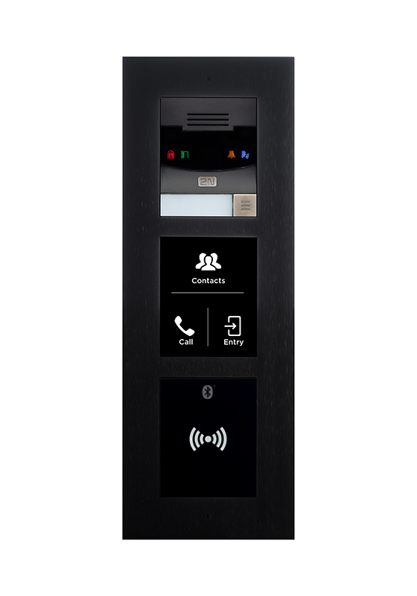
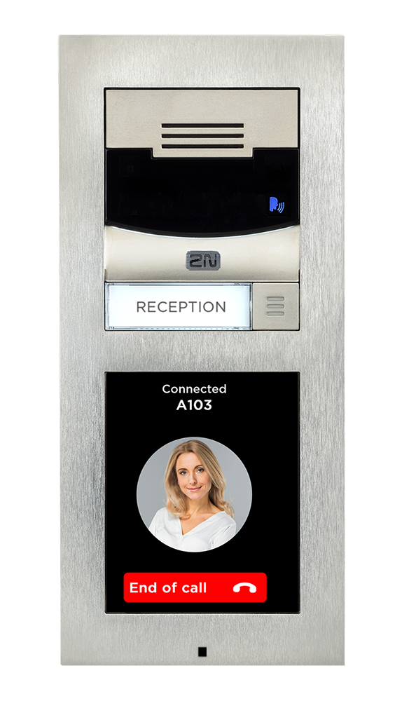
2N® IP Verso
Luxurious modular IP intercom
16 modules ideal for residential projects (Touch display, Bluetooth and Fingerprint reader, buttons, etc.)
Hidden HD camera with night vision
High grade materials, surface or flush installation, black or nickel colour
Integration with Property Management SW, Home automation SW, VMS, etc.
For office and residential
Modularity
Residential friendly AC
Notes:
Choose your configuration of the required number of buttons, extending modules like Display Touch screen, Bluetooth and many others.
Modules using different technologies like Bluetooth, RFID, optical fingerprint reader, capacitive touchscreen,
Hidden integrated camera produces sharp image with HD resolution and night vision so you will see all visitors clearly even in a dark night.
All used components and materials are industry grade and will provide excellent performance in any conditions.
High output power integrated amplifier together with HD audio codec will provide you crystal clear sound output with great intelligibility.
Full duplex sound processing ensures that you will always hear your visitor even in loud environments.
An integration with other security systems in the building brings an extra value and security. It works with open standards like ONVIF, HTTP based APIs and modern streaming features to integrate with video surveillance, burglar alarms or home automation systems.

Slide 9
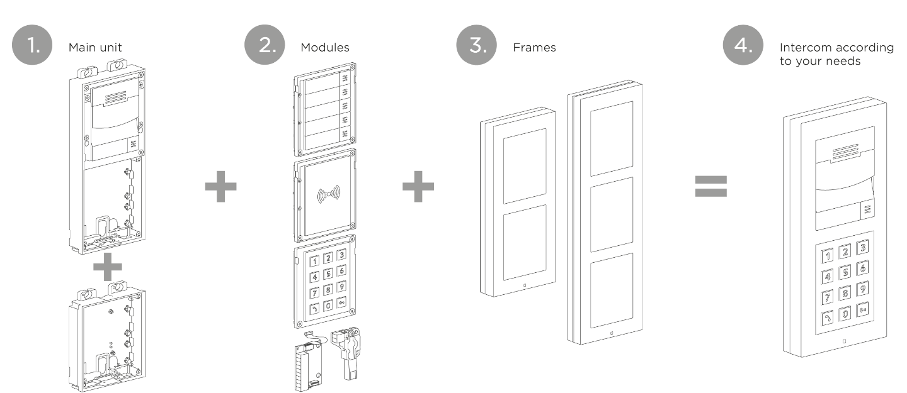
MODULARITY

Slide 10
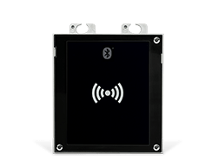
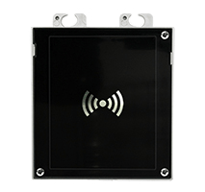
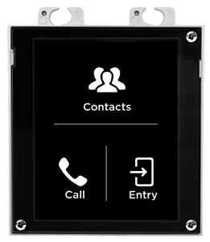
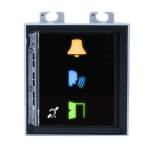
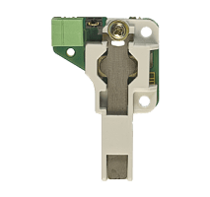
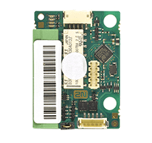
2N® IP Verso
PRODUCT VARIANTS - MODULES
Notes:
Max. of 30 modules (limited by power supply)
Touch display,
Bluetooth & RFID Reader 125 kHz, 13.56 MHz, NFC / Bluetooth & RFID Reader 125 kHz, secured 13.56 MHz, NFC
Touch Keypad & RFID Reader 125 kHz, 13.56 MHz, NFC / Touch Keypad & RFID Reader 125 kHz, secured 13.56 MHz, NFC
Bluetooth,
RFID card reader 125kHz / 13,56MHz/ 13,56MHz NFC,
Keypad,
5 buttons,
Infopanel,
Indooction loop,
Blind module

Slide 11
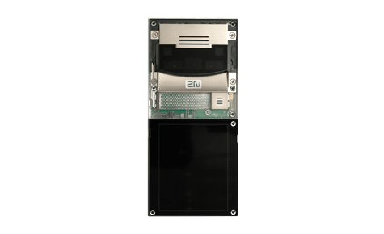
2N® IP Verso
PRODUCT VARIANTS – MAIN UNITS
Main unit
with camera - nickel
9155101C
Main unit
with camera - black
9155101CB
Main unit
without camera - nickel
9155101
Main unit
without camera - black
9155101B
Notes:
2-frame x 3-frame

Slide 12
2N® IP Verso
PRODUCT VARIANTS - MODULES
Touch Display
9155036
RFID card reader 125kHz
9155032
RFID card reader 13.56MHz NFC
91550942
Secured RFID card reader 13.56MHz
9155086
Notes:
Max. of 30 modules (limited by power supply)

Slide 13
2N® IP Verso
PRODUCT VARIANTS - MODULES
Bluetooth & RFID Reader 125 kHz, 13.56 MHz, NFC
9155082
Bluetooth & RFID Reader 125 kHz, secured 13.56 MHz, NFC
9155084
Touch Keypad & RFID Reader 125 kHz, 13.56 MHz, NFC
9155081
Touch Keypad & RFID Reader 125 kHz, secured 13.56 MHz, NFC
9155083
Notes:
Max. of 30 modules (limited by power supply)

Slide 14
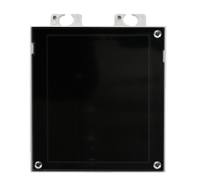
2N® IP Verso
PRODUCT VARIANTS - MODULES
Keypad
9155031
5 Buttons
9155035
Infopanel
9155030
Induction loop
9155041
Blind Module
9155039

Slide 15
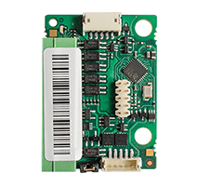
2N® IP Verso
PRODUCT VARIANTS - MODULES
I/O
9155034
Wiegand
9155037
Tamper switch
9155038

Slide 16
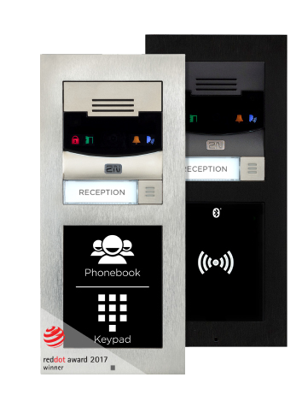
2N® IP Verso
Technical Specification
Signaling protocol: SIP 2.0 (RFC - 3261)
Microphone: 1 built-in microphone, Speaker 2W
Camera (optional) Resolution: JPEG 1280 x 960px – video call 640 x 480px
Viewing angle 120° (H), 90° (V), 145° (D)
Night vision: Yes Automatic IR cut filter and IR light
Video stream: Codecs H.263+, H.263, H.264, MJPEG, MPEG-4
Power supply: 12V ± 15%/ 2A DC, or PoE 802.3af (Class 0 - 12.95W)

Slide 17
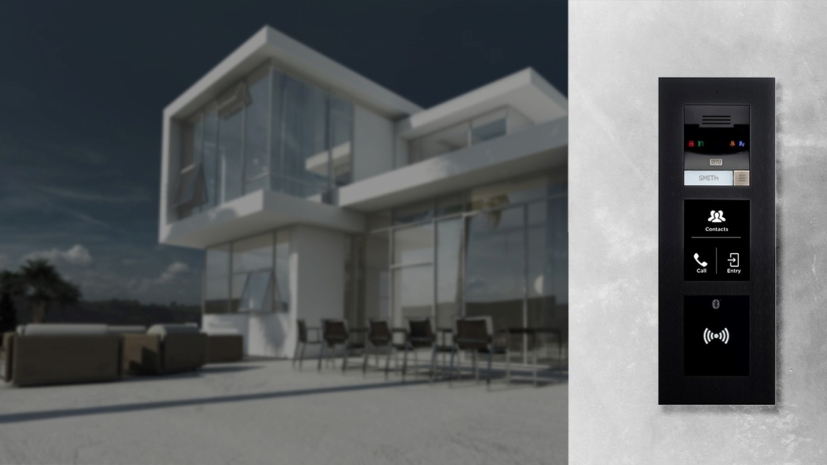
2N® LTE VERSO
World’s first
lte intercom

Slide 18
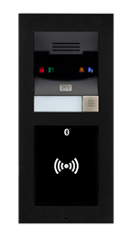
2N® LTE Verso
Ideal retrofit solution
Combines minimum installation costs with a full-feature set → only SIM card needed
Secure configuration and management via My2N cloud
Internal antenna inside with possibility for external antenna connection
Integration with Property Management SW, Home Automation SW, VMS, etc.
For retrofit
Only SIM needed
Modularity

Slide 19
2N® LTE Verso
PRODUCT VARIANTS – MAIN UNITS
Main unit
EU LTE - nickel
9155401C-E
Main unit
EU LTE - black
9155401CB-E
Main unit
US LTE - nickel
9155401C-U1
Main unit
US LTE - black
9155401CB-U1
Notes:
2-frame x 3-frame

Slide 20
2N® LTE Verso
PRODUCT VARIANTS - MODULES
Notes:
Same modules as for IP Verso
Max. of 30 modules (limited by power supply)
Touch display,
Bluetooth & RFID Reader 125 kHz, 13.56 MHz, NFC / Bluetooth & RFID Reader 125 kHz, secured 13.56 MHz, NFC
Touch Keypad & RFID Reader 125 kHz, 13.56 MHz, NFC / Touch Keypad & RFID Reader 125 kHz, secured 13.56 MHz, NFC
Bluetooth,
RFID card reader 125kHz / 13,56MHz/ 13,56MHz NFC,
Keypad,
5 buttons,
Infopanel,
Indooction loop,
Blind module

Slide 21
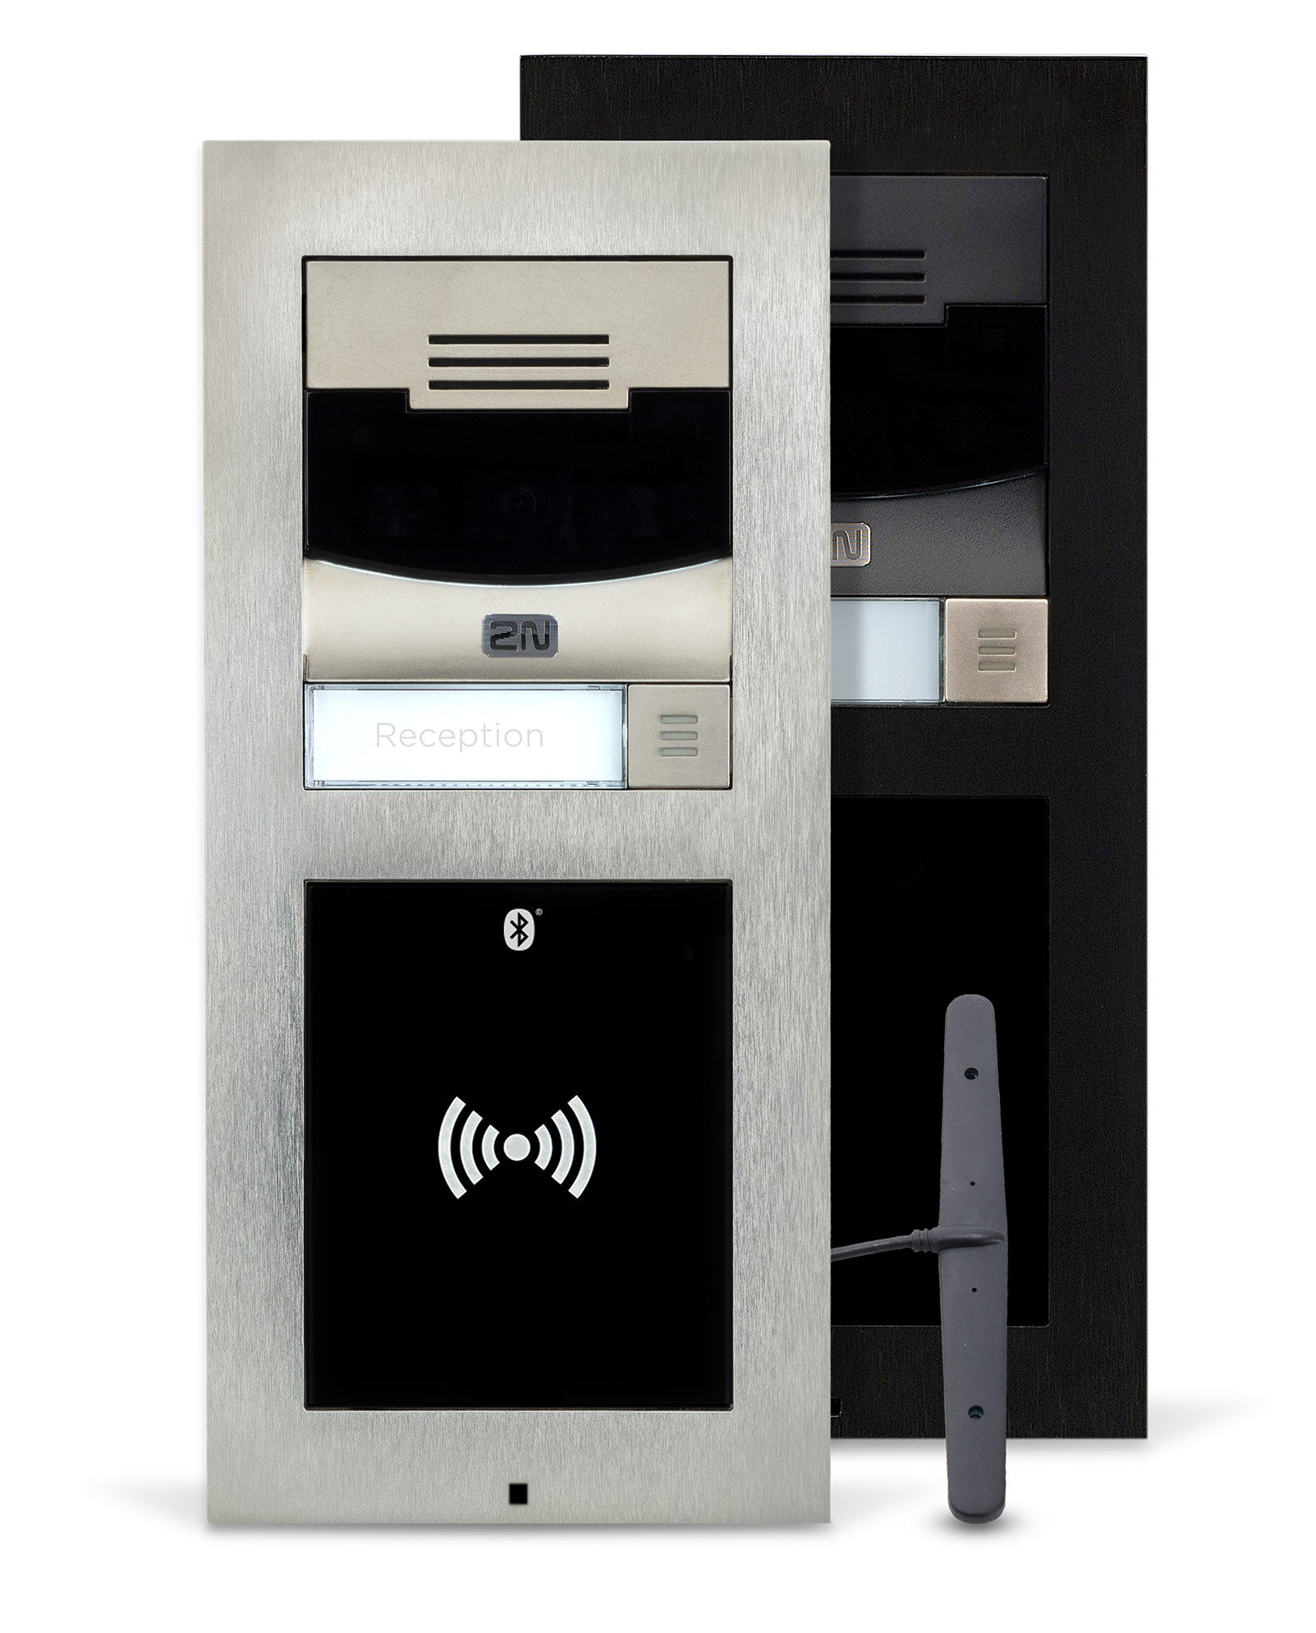
2N® LTE Verso
Technical Specification
Signalling protocol: SIP 2.0 (RFC- 3261)
Microphone: 1 built-in microphone
Camera resolution: 1280 x 960px (JPEG), 640 x 480px (video call)
Viewing angle: 120° (H), 90° (V), 145° (D)
Video stream codecs: H.263+, H.263, H.264, MJPEG, MPEG-4
Power supply: 12V ± 15%/ 2A DC
Network connection: LTE FDD Cat.1, 3GPP release 9 compliant
4G Bands (MHz): B1(2100), B3(1800), B7(2600), B8(900), B20(800)
Output power - Class 3 (0.2 W, 23 dBm) @ LTE

Slide 22
2N® Ip solo
Compact ip intercom ideal
For home automation

Slide 23
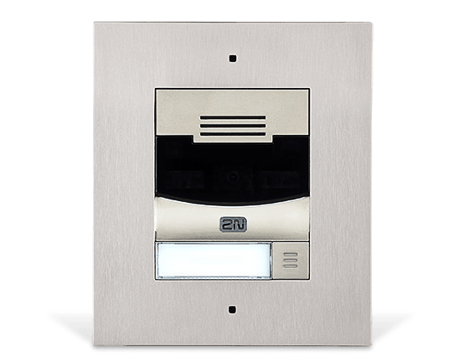
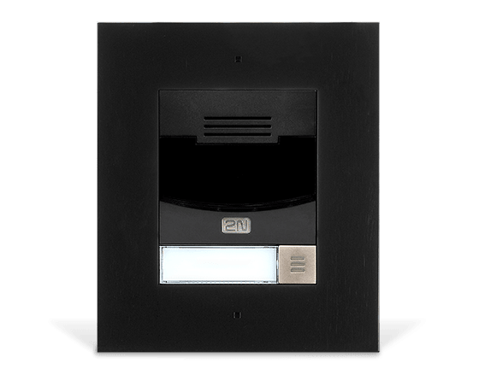
2N® IP Solo
Entrance to your Smart Home
Small package, just one button, video calls
Hidden HD camera with night vision
Snapshots of the visitor to your email
Integration with home automation systems (Open HTTP API, SIP, ONVIF S, RTSP streaming, automation functionality)
For smart homes
Compact size
Notes:
Video calls and door control int
A luxurious surface of brushed zinc represents any entrance in style.
All components and materials are industrial high-grade so as to ensure excellent performance under any conditions.
Integrate into your smart home system.
Various integration scenarios with a lot of Home Automation systems thanks to open HTTP API, Automation functionality in Helios IP and ONVIF support.
motion detection to reveal trespassers
ONVIF for integration to VMS
interconnection with smart home devices

Slide 24
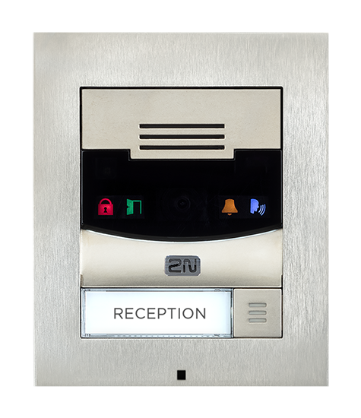
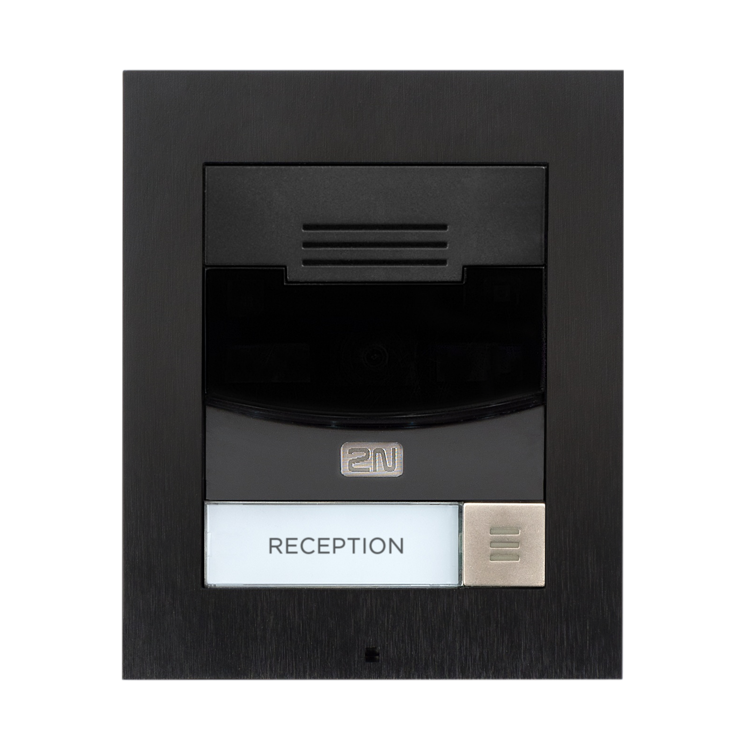
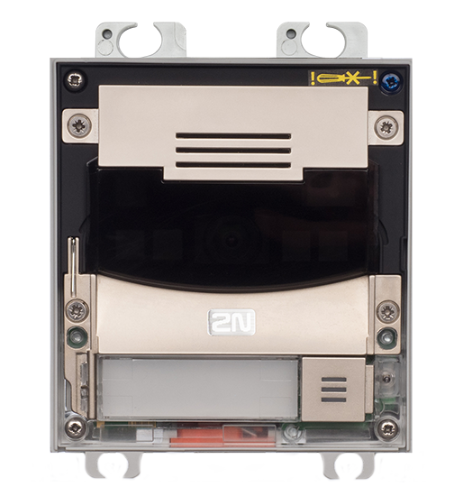
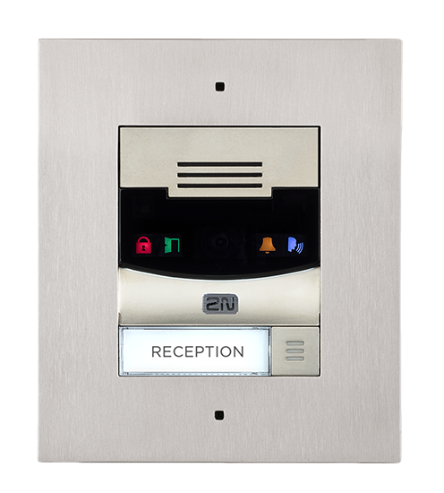
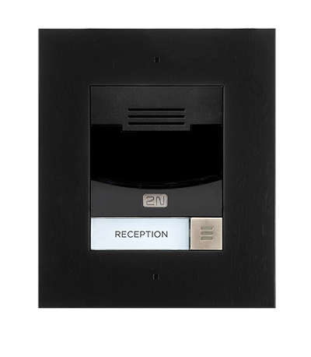
2N® IP Solo
Main units with camera
Main unit – nickel
surface mounted
9155301CS
Main unit – black
surface mounted
9155301CBS
Main unit – nickel
flush mounted
9155301CF
Main unit – black
flush mounted
9155301CBF

Slide 25
2N® IP Solo
Main units without camera
Main unit – nickel
surface mounted
9155301S
Main unit – black
surface mounted
9155301BS
Main unit – nickel
flush mounted
9155301F
Main unit – black
flush mounted
9155301BF

Slide 26
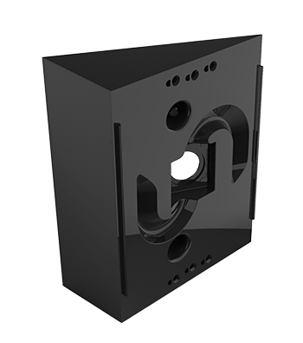
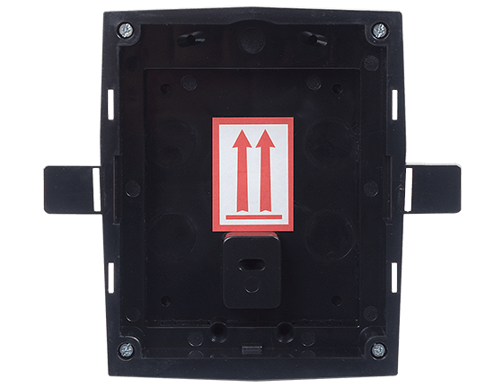
2N® IP Solo
Accessories
Backplate
9155068
Wedge Backplate
9155071
Glass Mount
9155074
Box for recessed installation
9155017

Slide 27
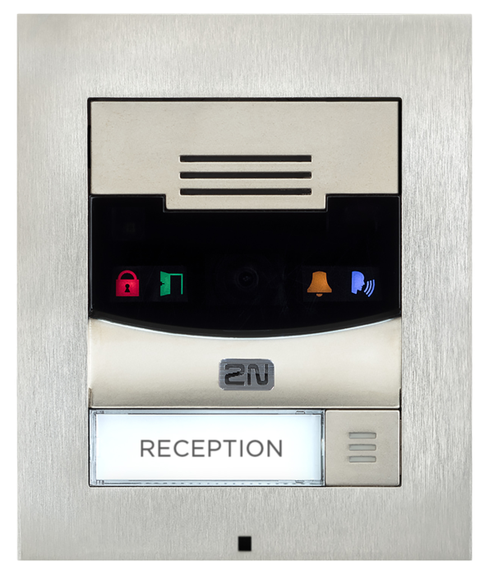
Technical Specification
Signalling protocol: SIP 2.0 (RFC - 3261)
Microphone: 1 built-in microphone, Speaker 2W
Camera (optional) Resolution: JPEG 1280 x 960px – video call 640 x 480px
Viewing angle 120° (H), 90° (V), 145° (D)
Night vision: Yes Automatic IR cut filter and IR light
Video stream: Codecs H.263+, H.263, H.264, MJPEG, MPEG-4
Power supply: 12V ± 15%/ 2A DC, or PoE 802.3af (Class 0 - 12.95W)

Slide 28
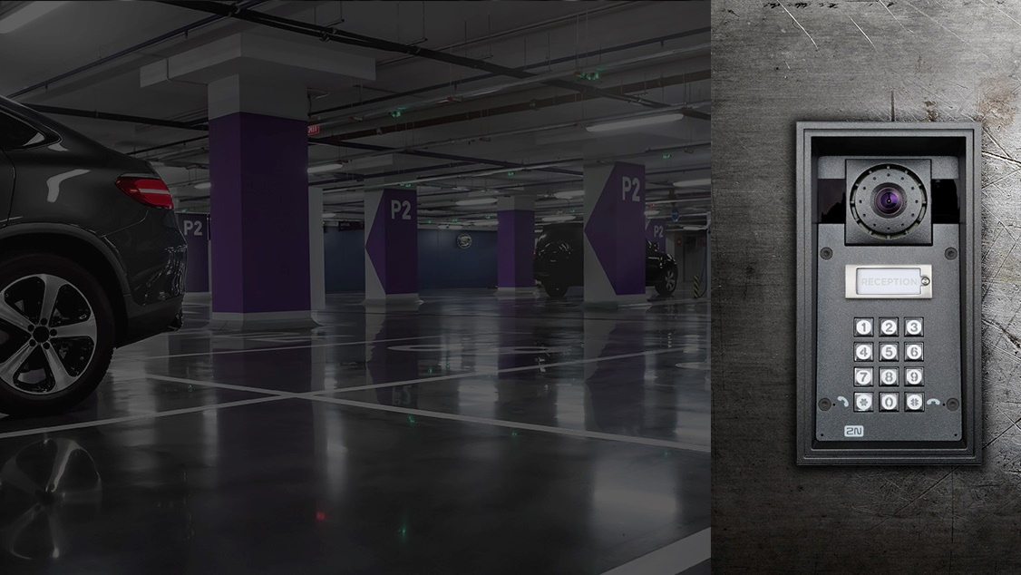
2N® IP force
withstands even the most demanding conditions

Slide 29
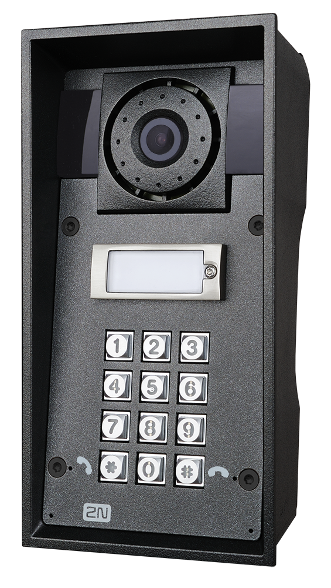
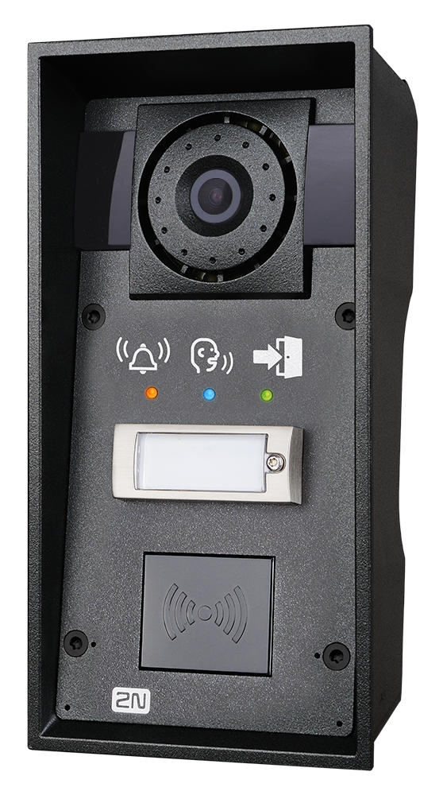
2N® IP Force
Most durable intercom on the market
HD camera (wide viewing angle and night vision)
Clear sound in noisy environments (10W speaker, integrated amplifier and two microphones)
Integrated access control (buttons, keypad or RFID reader)
Gooseneck stand as an accessory for easy mounting
Integration with VMS (ONVIF, RTSP) or telephony (SIP)
For garages
Anti-vandal
Integrated access control
Notes:
Ideal for car parks thanks to its durability and clear sound
Gooseneck stand as an accessory for easy mounting
You can drive with a tank over this intercom and it will still work well thanks to it’s vandal proof construction. All used components and materials are industry grade and will provide excellent performance in any conditions.
The integrated camera is producing sharp image with HD resolution and night vision so you will see all visitors clearly even in a dark night.
Possibility of video recording
High output power integrated amplifier together with HD audio codec will provide you crystal clear sound output with great intelligibility.
Full duplex sound processing ensures that you will always hear your visitor even in loud environments.
2N® Helios IP Force can be equipped by keypad or RFID reader and serve as extremely durable access control reader with camera for visitors with RFID card and as intercom for visitors that need to call reception.

Slide 30
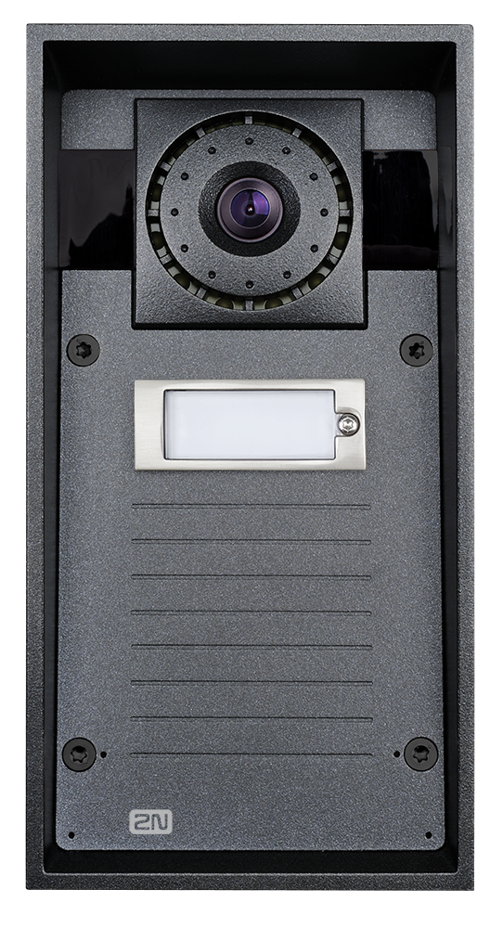
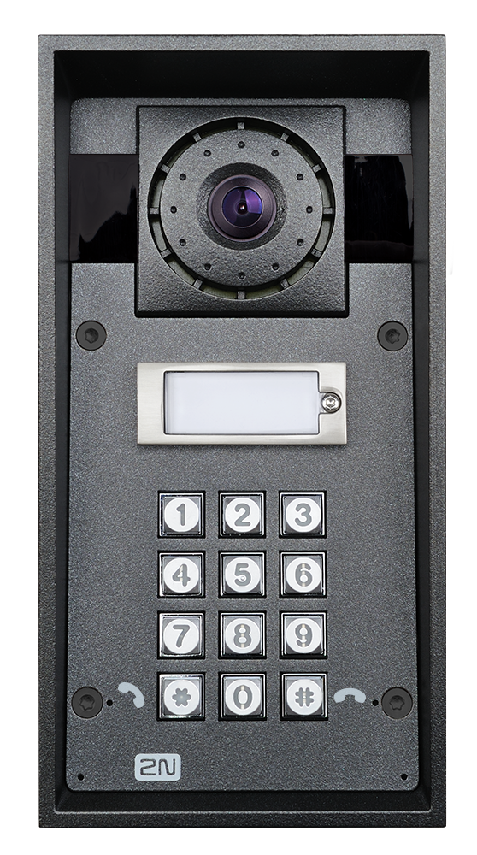
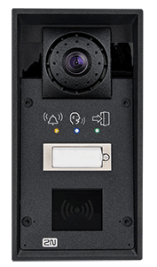
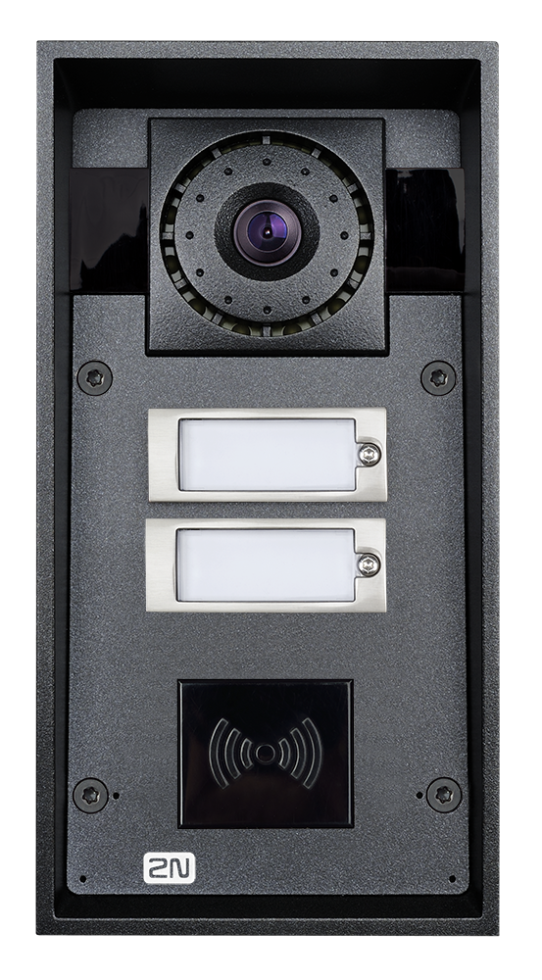
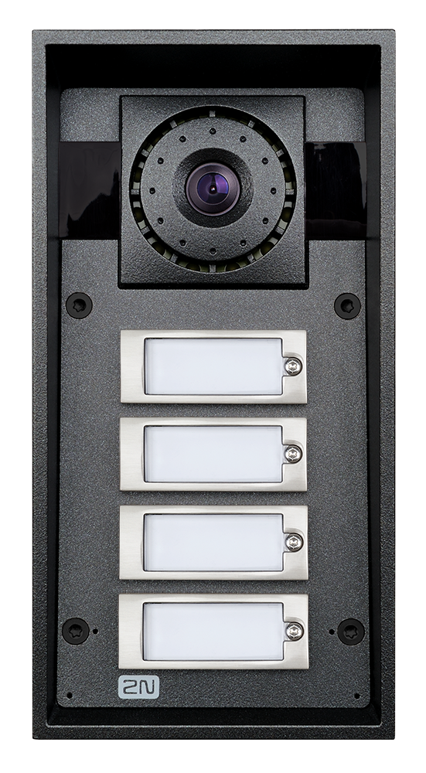
2N® IP Force
Variants
1 Button + HD Camera
9151101CHW
1 Button + HD Camera + Keypad
9151101CHKW
Pictograms + 1 Button + HD Camera + RFID reader
9151101CHRPW
2 Buttons + HD Camera + RFID reader
9151102CHRW
4 Buttons + HD Camera
9151104CHW
Notes:
Variants without camera also available.

Slide 31
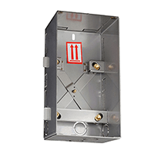
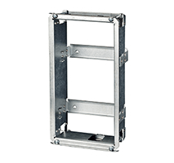
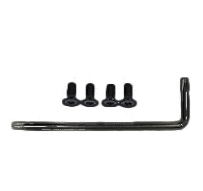
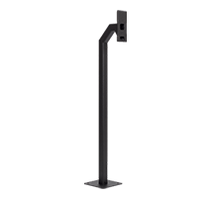
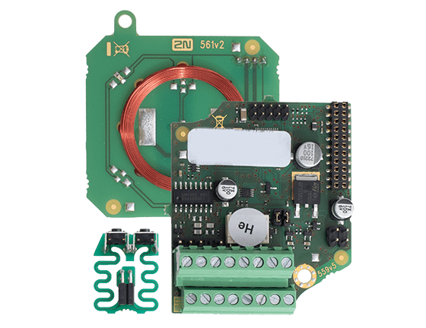
2N® IP Force
Accessories
Brick Flush Mounting Box
9151001
Plasterboard Flush Mounting Box
932061E
Security Screws
9151018
Gooseneck Stand
9151005
Secured Card Reader NFC Ready 13.56MHz
9151031S

Slide 32
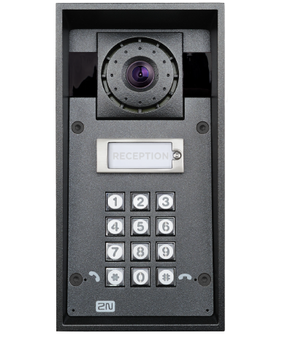
2N® IP Force
Technical Specification
Signaling protocol: SIP 2.0 (RFC - 3261)
Microphone: 2 built-in microphone, Speaker 10W
Camera (optional) : JPEG 1280 x 960px, video call 640 x 480px
Night Vision: Yes
Viewing angle 135° (H), 109° (V)
Audio stream: Codecs G.711, G.729, G.722, L16/16kHz
Video stream: Codecs H.263+, H.263, H.264, MJPEG
Power supply: 12V ± 15%/ 2A DC, or PoE 802.3af (Class 0 - 12.95W)

Slide 33
2N® IP safety
Sturdy IP intercom
for emergency situations

Slide 34
2N® IP Safety
Robust emergency IP intercom
Distinctive orange colour and blue backlit buttons
Reliable connection with assistance centre
Suitable for any conditions
Automatic Audio Loop Test
Clear sound in noisy environments (10W speaker, two mics, integrated amplifier)
Integration with VMS (ONVIF, RTSP) or telephony (SIP)
SOS point
Anti-vandal
10W speaker
Notes:
It is very important to immediately call help in case of emergency. This intercom has proven to be reliable solution even for people using it for the very first time in high stress conditions.
You can drive with a tank over this intercom and it will still work well thanks to it’s vandal proof construction. All used components and materials are industry grade and will provide excellent performance in any conditions.
High output power integrated amplifier together with HD audio codec will provide you crystal clear sound output with great intelligibility.
Full duplex sound processing ensures that you will always hear your visitor even in loud environments.
Integration with existing video surveillance system - > Integration with external cameras to create a full city surveillance system.

Slide 35
2N® IP Safety
Variants
1 Button + 10W Loudspeaker
9152101W
2 Buttons + 10W Loudspeaker
9152102W
1 Emergency Button + 10W Loudspeaker
9152101MW

Slide 36
2N® IP Safety
Accessories
Brick Flush Mounting Box
9151001
Plasterboard Flush Mounting Box
932061E
Frame
9152000
Gooseneck Stand
9151005

Slide 37
2N® IP Safety
Technical Specification
Signaling protocol: SIP 2.0 (RFC - 3261)
Microphone: 2 built-in microphone, Speaker 10W
Audio stream: Codecs G.711, G.729, G.722, L16/16kHz
Supported protocols: SIP2.0, DHCP opt. 66, SMTP, 802.1x, RTSP, RTP, TFTP, HTTP, HTTPS, Syslog, ONVIF
Power supply: 12V ± 15%/ 2A DC, or PoE 802.3af (Class 0 - 12.95W)

Slide 38
2N® IP base
compact IP intercom
Suitable for family houses

Slide 39
2N® IP Base
Family house IP Intercom
Designed especially for smaller scale installations
10 min installation
Equipped by RFID card reader
HD resolution, no blind spots
One or two buttons, pictograms
Integration with Property Management, VMS and telephony systems
For family houses
Integrated access control
Easy installation
Notes:
All used components and materials are industry grade and will provide excellent performance in any conditions.
Integrated camera is producing sharp image with HD resolution and wide viewing angle so you will see all visitors clearly and you will have no blind spots.
2N® IP Base can be equipped by RFID card reader for access control purposes and can be managed by 2N® Access Commander in large installations.
Installation is trivial. The whole product including mounting accessories are delivered in 1 package.
10 min installation
ready out of the box
plug via PoE
quick mounting frame

Slide 40
2N® IP Base
Main units
2N® IP Base
9156111CB

Slide 41
2N® IP Base
Accessories
Installation Plate
9156020
125 kHz RFID Card Reader
9156030
13.56 MHz RFID Card Reader
9156031

Slide 42
2N® IP Base
Technical Specification
Signalling protocol: SIP 2.0 (RFC - 3261)
Microphone: 1 built-in microphone, Speaker 2W
Camera (optional) Resolution: JPEG 1280 x 960px
Viewing angle 135° (H), 109° (V)
Audio stream: Codecs G.711, G.729, G.722, L16/16kHz
Video stream: Codecs H.263+, H.263, H.264 only for VoIP calls
Power supply: 12 V/2 A DC, or PoE 802.3af (Class 0 - 12.95W)

Slide 43
2N® IP uni
afforDable IP intercom
Ideal as an info point

Slide 44
2N® IP Uni
Affordable IP intercom
Ideal solution for communication, fits into back entrances of residential projects or as an info point
Easy installation, both flush mount or surface
Build-in tamper switch to detect unauthorized removal from the wall
Visual signalization
Integration with telephony systems and IP PBX
Info point
Affordable
Notes:
Stainless steel front plate provides durability and flat design.
Vizual signalization: ringing, calling in progress, doors opening, suitable for hearing-impaired

Slide 45
2N® IP Uni
Variants
1 Button
9153101
Pictograms + 1 Button
9153101P
2 Buttons
9153102

Slide 46
2N® IP Uni
Accessories
Surface Mount Box
9153003
Security Relay
9159010
Strike with contact
932061E

Slide 47
2N® IP Uni
Technical Specification
Signalling protocol: SIP 2.0 (RFC - 3261)
Microphone: 1 built-in microphone, Speaker 1W
Audio stream: Codecs G.711
Supported protocols: SIP2.0, RTP, HTTP, HTTPS, Syslog
Power supply: 12 V/2 A DC, or PoE 802.3af (Class 0 - 12.95W)

Slide 48
CONNECTION TOPOLOGY

Slide 49
Top selling accessories
Accessories
Security Bundle for the 2N® IP/LTE Verso
9155198SET
Security Bundle for the 2N® IP Force
9151198SET
Security Relay
9159010
Tamper Switch
9155038

Slide 50
Top selling accessories
Accessories
AXIS A9188 Network I/O Relay Module for lifts
9160501
Electrical Strike 11211
932071E
External Fingerprint Reader (USB)
9137423E
Mifare Classic 1K RFID Card, 13.56MHz
9134173
Gooseneck Stand for 2N® IP Force and 2N® IP Safety
9151005

Slide 51
Access Control is not only about devices,
it is mainly about the software,
which is the brain of the solution and allows admin to control all devices from one place
SOFTWARE MAKES THE DIFFERENCE!

Slide 52
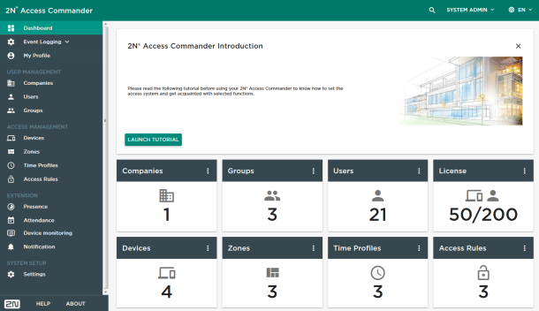
2N® Access Commander
Access control software which is easy to use by non-professionals
Bulk configuration and management of all connected 2N devices
Built-in Time & Attendance and Multiple site control
Distributed as an .ova file that has to be imported to dedicated virtual server or on embedded PC →
2N® Access Commander Box
Integration with 3rd party systems (VMS, T&A, alarm…)
Notes:
2N® Access Commander is a professional access control system that covers all basic functionalities typical for AC systems and it offers also much more.
Graphical tutorial helps you to understand the main idea of the software, ie. creation of ACCESS RULE (WHO + WHERE + WHEN)
Main idea of Access Control: who can enter which part of the building at which time
Software perfectly works for bulk configuration and management of 2N devices in large installations!
You can easily manage all IP intercoms and Access Units from one place without any need to configure them one-by-one.
You can also download the actual configuration for any of connected devices (HIP or AU) to Access Commander so you will not lose any of already created users!
Software is distributed as a complete image file that has to be imported to dedicated virtual server. It already includes web server, database server and all other applications.
It takes an advantage of an IT-friendly language which means that average IT guy will install this software within few minutes.
This distribution is suitable especially for larger companies.
2N® Access Commander Box – plug and play access control solution that is tailored to be installed within a minute by any installer. There is no need for a dedicated server in the company.
Intended mainly for SME market with up to 50 connected 2N devices.
Integration makes a life easier mostly to administrators and installers.
Therefore we’ve created 2N® Access Commander as a software that can be easily integrated with VMS, T&A, alarm and other 3rd party systems using the REST API web interface or special 2N plugin.
CRM ... customer relationship management
BMS ... building management systems (or property management or asset management solution)

Slide 53
My2N Cloud
My2N
Our professional cloud platform = source of your recurrent fees!
2N® Mobile Video – video calls from 2N IP intercoms to the smartphone via My2N cloud
2N® Remote Configuration – online remote management of all 2N devices without any network setup
2N® Partner API – integration of 2N products to 3rd party solutions over the Internet
Site Management – integrator has only one My2N account to manage different sites separately
Notes:
Cloud service MDU Ready
We have invested into the cloud services that are focused to professional offer (2tier distribution, integrations, OEM) - we have significant time advantage against all competitors in residential market in this field
Focus to modern services
Mobile video professionally made and focused to MDU / 2tier model
2N® Remote Configuration
No complicated network setup required
Save costs on travelling to the installation site
Offer online, immediate help to your customers
2N® Partner API
Single point of integration of 2N products into your solution over the Internet
Fulfils the best standards of cybersecurity
Available services via 2N® Partner API:
Video calls from 2N IP intercoms into your app
Remote configuration of 2N devices from your SW
Management of Access Control credentials via cloud
Monitoring of 2N IP intercoms and access units

Slide 54
Freely available tools to simplify your work
Network Scanner
Application for locating 2N IP devices in the LAN network
Makes system configuration easier
IP Eye
Displays video from an IP intercom on PC in the event of an incoming call
Ideal solution for regular desktop IP phone without a display
Also used as a basic VMS for 2N intercoms

Slide 55
Door control from reliable mobile apps
2N® Mobile Key
Free of charge app in a resident’s smartphone
Touch mode (unique) – leave the phone in a pocket and only touch the 2N IP intercom or Access Unit
Tap in app mode – open the 2N® Mobile Key app and tap an icon of the door you are going to open
2N® Mobile Video
Video calls from 2N IP intercoms to the smartphone via My2N cloud
Stay reachable anywhere you are with the most reliable cloud service on the market
Push notifications save battery life
Notes:
2N® Mobile Video
A paid service and recurrent fee paid by the end customers generates an extra margin for you and for your integrators. Thanks to the application you can answer any call wherever you are. Your smartphone is always wake up by push notifications and at the same time these notifications also save the battery life. The huge advantage is the easy remote management via My2N portal and end user doesn’t need to be afraid of any configuration – just simply scan a QR code. Finally, this service can be also integrated with your customer’s solutions - use 2N® Partner API to integrate this service to your own system / application
Available for Android and iOS devices
Recurrent fee paid by end customers

Slide 56
Reasons why to choose 2N
Solution according to the latest trends → IP based solution seamlessly integrated with other systems, providing HQ audio and video
Comprehensive Access Control portfolio → not only intercoms, but also standalone IP access units and luxurious answering units
Trusted services → easy to use access control software and cloud platform
which generates you recurring fees and reduces maintenance costs
Tools to help you with the projects from the scratch (A&E specs, CAD drawings,
2N Project Designer, 2N Academy, certifications, etc.)
Notes:
Advantages of our technology:
Simple wiring reduces time spent on the installation site
Openness for the integration with 3rd party systems
Open standards and proprietary protocols
Compatible with more than 200 solutions
Extensive API
Most of our competitors have traditional, non IP solution with many limitations
New buildings are mostly based on IP - you will have to face it – better with professional solution
Scalability of the whole system – no dead ends
Trusted services generating money and saving time
Full range offer for MDU including also Access Control
IP technology
Shorter time spent on the installation site
- One type of cabling, simple wiring, sharing of infrastructure - maintained by non-electricals (IT guys), no need for deep wiring knowledge
- Plug & play solution with PoE – only a switch is needed, easy backup
IP - potential to improve – Audio & Video quality superior to 2Wire…..
No 2Wire issues (hum buzz, noise, security, privacy ….. )
No limits (number of units, video streams, distance)
No dead ends

Slide 57
Offer the best
access control solution
to your customers

