Slide 1
2N® Partner API
Integrate 2N devices over the internet

Slide 2
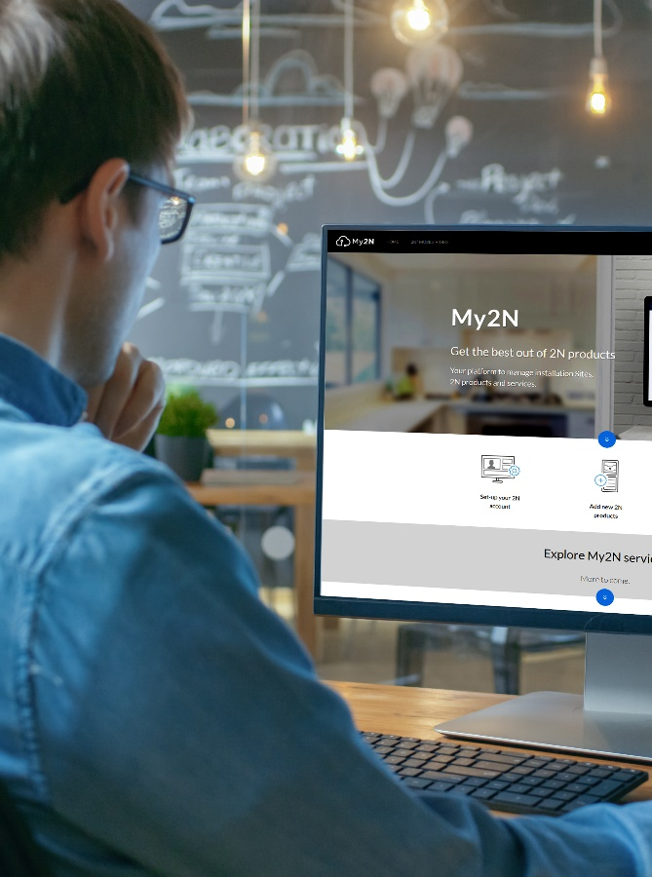
2N® Partner API
What is 2N® Partner API?
Single point of integration designed for My2N cloud
Interface to integrate 2N products and services with 3rd party systems
Cloud-based integration – over the Internet
Designed to enhance partner’s solutions with My2N Partner Services
Notes:
API = Application Programming Interface … set of functions, tools and protocols that allow the communication between different systems or applications
Partner API … robust, secure, fully documented REST API

Slide 3
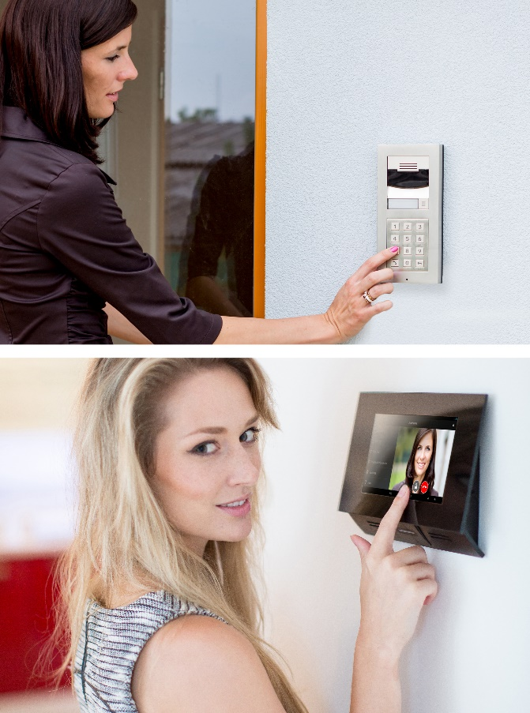
2N® Partner API
My2N Partner Services
Services available over the 2N® Partner API:
Video calls from 2N intercoms to smartphone
Remote configuration of 2N devices
Management of access credentials
Monitoring of 2N IP intercoms and access units
Notes:
My2N offers the following services that are available over 2N® Partner API. While adding new device to a specific Site, you can select which services will be activated for the device:
MOBILE VIDEO – service allowing video calls between devices (e.g. 2N IP intercoms and 3rd party mobile applications) using cloud SIP Proxy.
RESIDENTIAL ACCESS CONTROL - can be used to manage basic access control like to add users with PIN code, RFID card or BLE credential to 2N IP access control devices (IP intercoms, access control readers)
REMOTE CONFIRUGATION – can be used to establish a VPN tunnel between the 2N device (IP intercom, Access Unit) and the cloud without any need for sophisticated configuration of routing rules, NAT and port forwarding
INTERCOM MONITORING – allows setup of various monitoring features (like tamper switch alert, audio loop test, door forced open, door open too long, etc.)

Slide 4
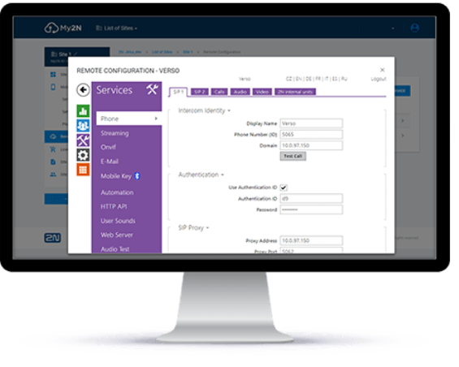
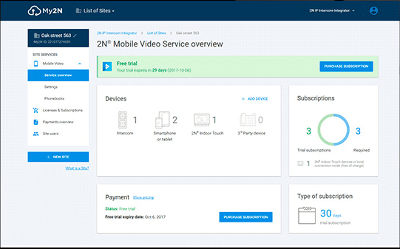
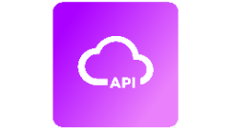
2N® Partner API
My2N Partner Services are tailored for partner’s SW and apps using their own GUI
My2N Cloud Services are available for 2N customers via My2N.com portal
PARTNER’S MOBILE APP
END USER
PARTNER’S SOFTWARE (CRMS, PMS, ERP)
PARTNER’S CLOUD
Notes:
My2N Cloud services are accessible via My2N.com portal – services are 2N® Mobile Video, 2N® Remote Configuration (Beta version), License Purchase - intended for 2N customers (end users, distributors, integrators). Customers are using My2N.com portal and see the 2N brand. Special service is called 2N® Partner API.
2N® Partner API is special interface to integrate Mobile Video, Remote Configuration, Device Monitoring or Residentail Access Control into 3rd party software or application. It is for developers, integrators with their own service platform… who integrate our products and services into their solutions. The end users don´t see the 2N brand, but the brand of partner!

Slide 5
2N® Partner API
VERTICALS
Residential
Apartment building
Residential
Single house
Commercial
Office building

Slide 6
2N® Partner API
Eliminates difficult network setup
Control 2N products over the Internet from your software
No setup of firewalls, NAT, routing rules, etc.
Remote configuration, auto-provisioning and monitoring of 2N IP products*
Online management of users and their credentials
* 2N IP devices need the connectivity to the Internet
Notes:
Eliminates complicated setup of network infrastructure … there is no need to set up complicated network infrastructure, port forwarding and routing rules. Just plug the 2N IP devices to the Internet and configure everything online from your software (FMS, ERP, CRM) thanks to the 2N® Partner API
Remote configuration is a tool for remote configuration of 2N devices when a VPN tunel is set up (automatically by 2N back-end solution) between the device and cloud (My2N). Then a partner receives an address of the temporary web for 2N device configuration.
Monitoring of 2N devices – get a building under control. Ensure steady functioning of IP intercoms and monitor them together with other systems and devices from your software. Set up various monitoring features like tamper switch alert, door forced open, audio loop test, connection status (online x offline), etc.

Slide 7
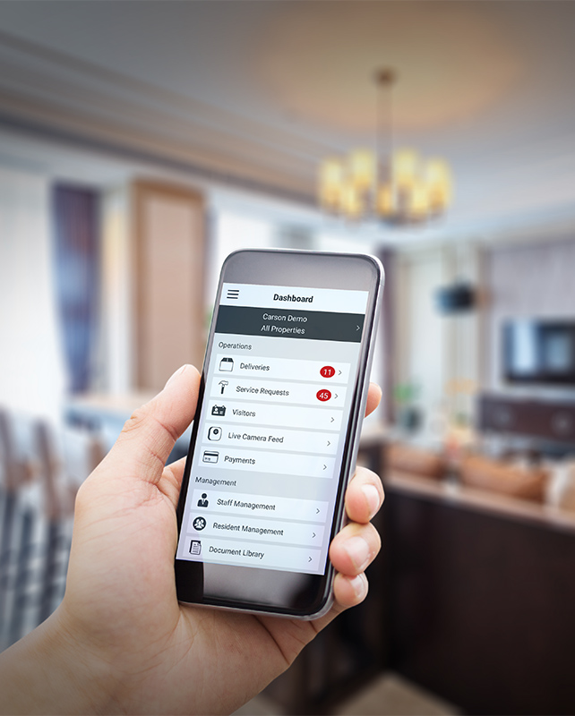
2N® Partner API
Enhances your own-brand solution
Offer your application or software extended by trusted 2N services
Video calls from 2N IP intercoms to your app
Unlock the door through your app via Bluetooth
Manage resident’s credentials from your SW
2N delivers revolutionary service while you stay focused on your product and its GUI!
Notes:
Site managers appreciate managing all important data and communicate with residents from one platform. With 2N Partner API, they can manage access and add users with PIN code, RFID card or BLE credentials from anywhere via the same user interface. So your software tailored to facility managers can be used also for access control management and remote configuration of 2N devices.
Your Home Automation app intended for light, HVAC, or music control can be enhanced by video communication with 2N IP intercoms and also by keyless entry via Bluetooth transforming the smartphone to modern keys.
You can stay focused on your product with its user interface, providing the best user experience to your customer and 2N will také care of providing the service on the background. Then, end users benefit from a single interface to configure and use the solution.

Slide 8
2N® Partner API
Rely on a robust and secure API
2N® Partner API fulfils the best standards of cybersecurity
My2N cloud is hosted on Amazon AWS
Designed to provide scalability & availability
Encrypted, secure communication
Comprehensive and clear documentation
Notes:
Robust and secure REST API - 2N Partner API fulfils the best standards of cyber security.
The My2N cloud solution providing Partner API is scaled to provide high availability - the solution has microservice oriented architecture to provide scalability and availability.
The API is well documented - comprehensive and clearly written documentation in Apiari (software for API documentation allowing to immediately try all API commands).
AWS … Amazon Web Services

Slide 9
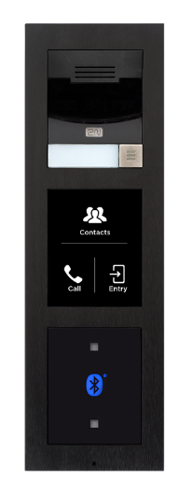
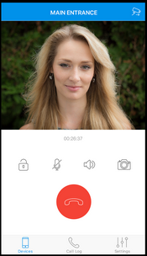
2N® Partner API
Video call from IP intercom to the app
PARTNER’S NEED
Supplement their own app (e.g. home automation) app by the ability to receive a video call from 2N IP intercom and offer a single app for the whole smart living to their customers!
SOLUTION: 2N® Mobile video service
Finally resident can open door remotely from the app
Visitor presses an intercom’s call button
My2N cloud with 2N® Mobile Video service wakes up your app by the push notification
Resident receives the video call, verify the person and starts to talk
Notes:
Residents want to have one application for complete control of their smart home – it means typically for HVAC, light or music control, but also for door communication.
Tune your own mobile application (3rd party one) with new functionalities like receiving video calls from 2N Intercoms. 2N® Mobile Video service works as a SIP Proxy server and can be easily embedded in your own application via 2N® Partner API. Therefore even with your existing home automation application residents can receive a video call from 2N IP intercoms with video preview before they decide to accept the call on the smartphone, they can see the video from IP intercom whenever they want to check the situation in front of the house and finally, they can also use the app to control the door remotely.
Undelivered packages, unexpected visits. How to control doors and provide a warm welcome anytime from anywhere? How to make home automation application a part of door communication solution?

Slide 10
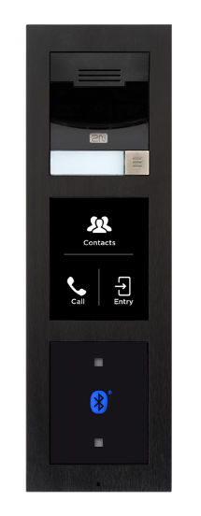
2N® Partner API
Facility management & 2N
PARTNER’S NEED
Facility managers deal with many systems (accounting system, CRM, building technologies like access control or HVAC, etc.). How to automate processes and avoid human errors?
SOLUTION: 2N AUTO-PROVISIONING
Display of 2N IP intercoms is updated as well. User’s PIN codes, RFID cards or mobile credentials can be used
Site manager creates a new resident in Facility Management Software
Users’ directory is automatically updated in 2N IP intercoms (phone numbers, credentials)
Notes:
Site managers would appreciate managing all important data and communication with residents from ONE PLATFORM.
A single user-interface for a workflow management in buildings. It is typically integrated with many IT systems for planning, customer relations, invoicing and building technologies, like access control or HVAC.
Data of residents are needed across the systems including intercoms and access units.

Slide 11
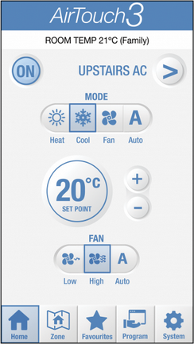
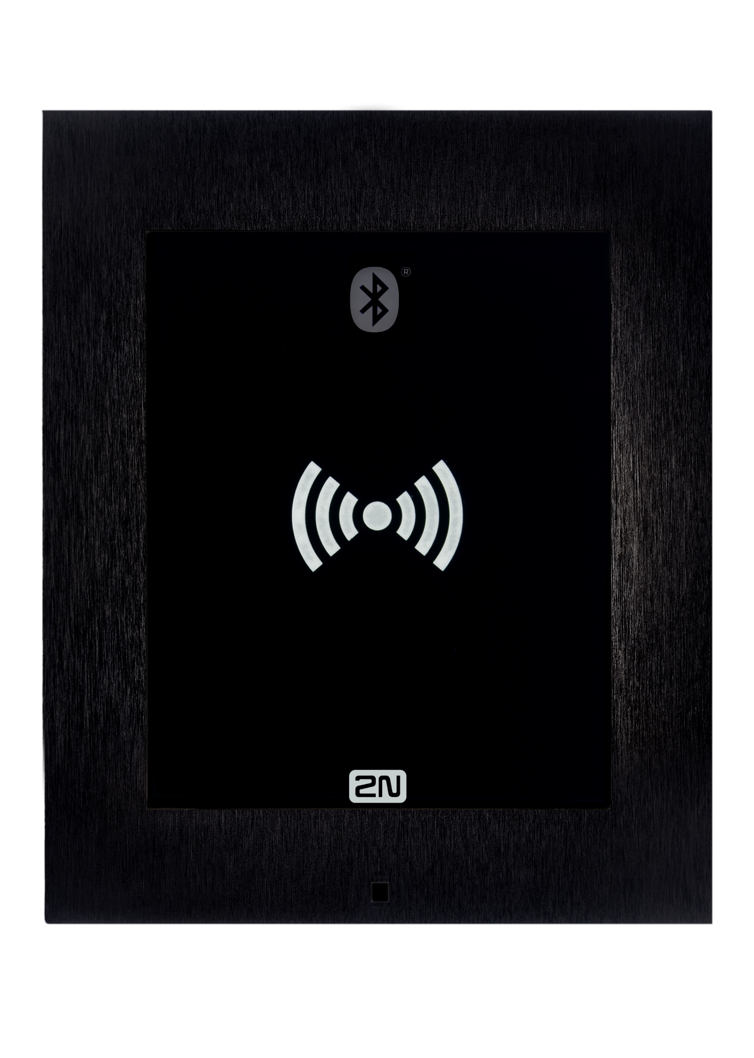
2N® Partner API
Keyless access from your app
PARTNER’S NEED
Let residents use your app they are using on a daily bases for other purposes also as a “mobile” key for their door. Allow them to share access credentials with their neighbours, friends remotely via cloud.
SOLUTION: 2N residential access control
Resident installs 3rd party mobile app and receives Bluetooth credential
Those people install the same app and use it as a ”key” to the building
When approaching a door, he only touches 2N Access Unit to open the door
Resident can also generate a temporary access and share it with other people
Notes:
With the integration, residents and managers will now be able to control common area access points for entry gates, clubhouses, gyms, and laundry facilities with the same app they use to control and manage their smart apartments.
Tune your mobile application and allow residents to control the door via Bluetooth. Further more, your system (software even mobile app) can generate your own Bluetooth access credentials and upload them to 2N IP intercom and Access Unit over 2N Partner API. Provide access credentials from your mobile application to other users – your neighbours or friends and let them go into your house in style.

Slide 12
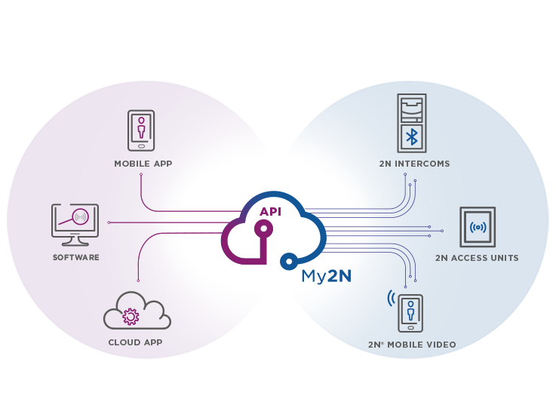
2N® Partner API
CONNECTION TOPOLOGY
3rd party solution (app, SW, cloud)
2N products and services

Slide 13
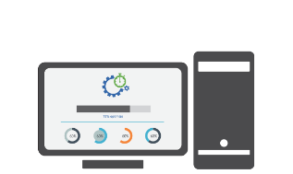
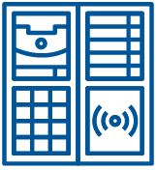
2N® Partner API
EXAMPLE: Property Rental Management
Administrators configure and monitor devices remotely from their building management SW
3rd party SW sends following request via 2N® Partner API: create user „X“ in „Y,Z“ devices with „ABC“ PIN code
Internet
My2N distributes the information to appropriate devices („Y, Z“)
6
Administrator
My2N
3
Property
4
2N® Partner API
User makes an online reservation of the flat in 3rd party application
rentapartment.com
1
2
He receives the confirmation with the access PIN code
User enters the PIN code to enter the building and flat
5
End user
Notes:
1. User makes an online reservation of the flat
2. He receives the confirmation with access PIN code
3. 3rd party SW sends following request via 2N® Partner API: create user „X“ in „Y,Z“ devices with „ABC“ PIN code
4. My2N distributes the information to appropriate devices („Y, Z“)
5. User enters the PIN code to enter the building and flat
6. Administrator configure and monitor devices remotely from his building management SW

Slide 14
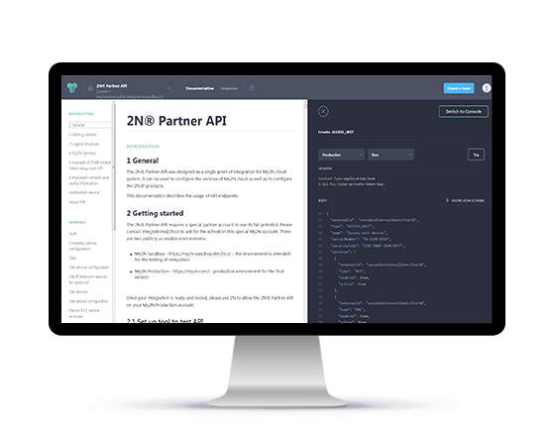
2N® Partner API
Technical Specifications
General requirements
The 2N® Partner API is a REST API provided by the My2N cloud portal using Amazon AWS services.
A contract must be concluded with 2N for the use of the 2N® Partner API, regulating the legal particulars relating to the GDPR and determining the conditions for use of the service including an SLA (Service Level Agreement).

Slide 15
2N® Partner API
Contact integrations@2n.cz to explore its full potential!

