Slide 1
2N® Meeting Room
Scheduled meetings clearly on 2N® Indoor Touch 2.0
Notes:
Nainstalujte jednotku 2N® Indoor Touch 2.0 před konferenční místnost a dopřejte uživatelům přehled o právě probíhajících i následujících schůzkách. To vše díky nové aplikaci 2N® Meeting Room. A pokud mají štěstí a místnost je zrovna volná, mohou si ji hned na místě zarezervovat. Aplikace podporuje synchronizaci sdíleného kalendáře s platformami Microsoft Office 365, Microsoft Exchange, Google Gmail nebo Zimbra.

Slide 2
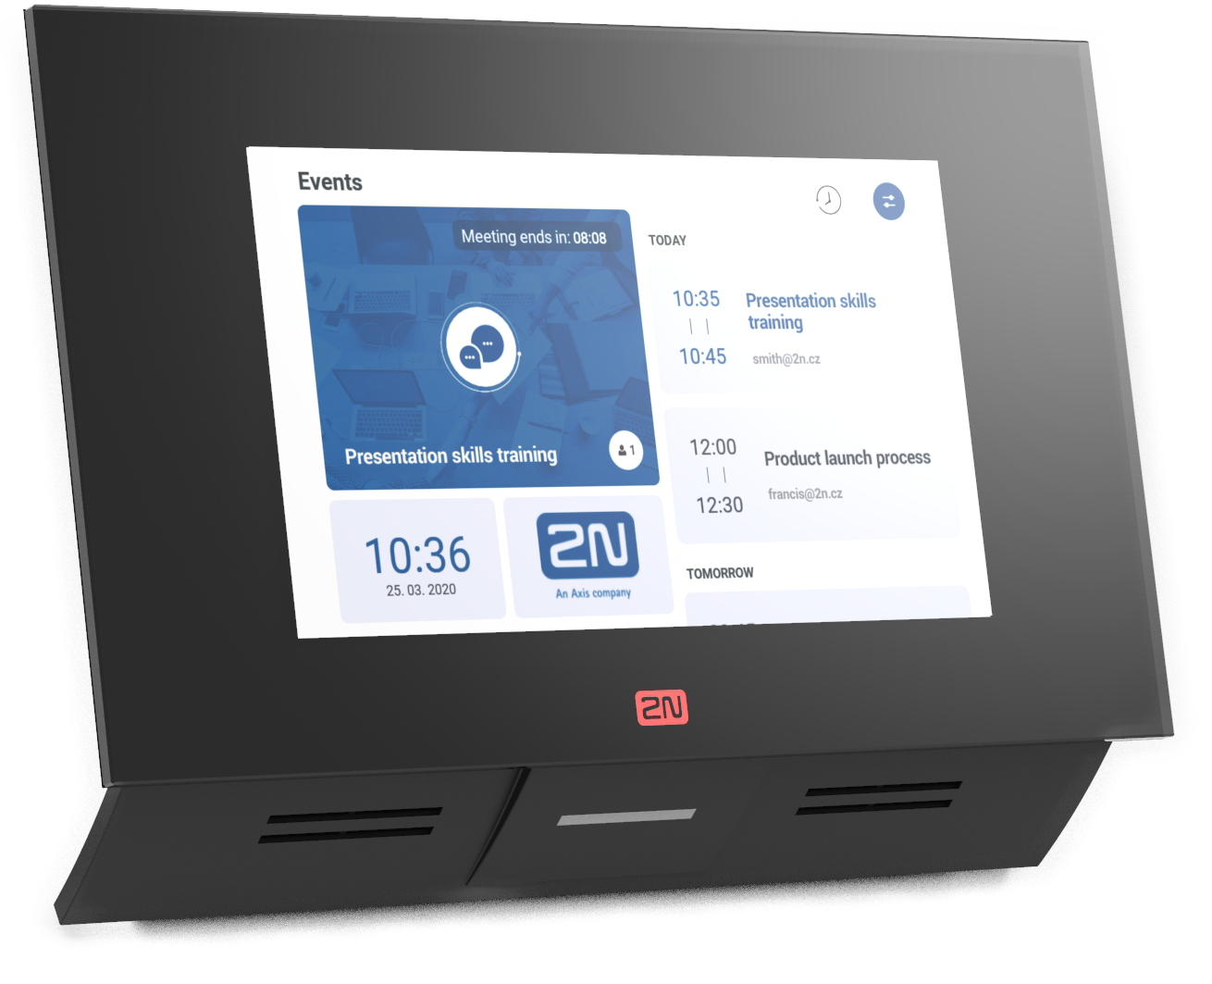
Key benefits of the app
Synchronization with the most used shared calendars
Full overview of scheduled occupancy for meeting rooms
Immediate (ad hoc) room reservation from the panel

Slide 3
What does the app offer?
7’’ panel with attractive design
Quick on-wall installation
Display protected by tempered glass
Industry-grade components
Meeting room name
Application settings
(administrator mode)
Details of current meeting
(name, remaining time, list of participants)
List of subsequent meetings
(name, time, organizer’s name)
Colour status indicator
(green, red, orange)
Additional widgets (date and time, weather, logo, picture)

Slide 4
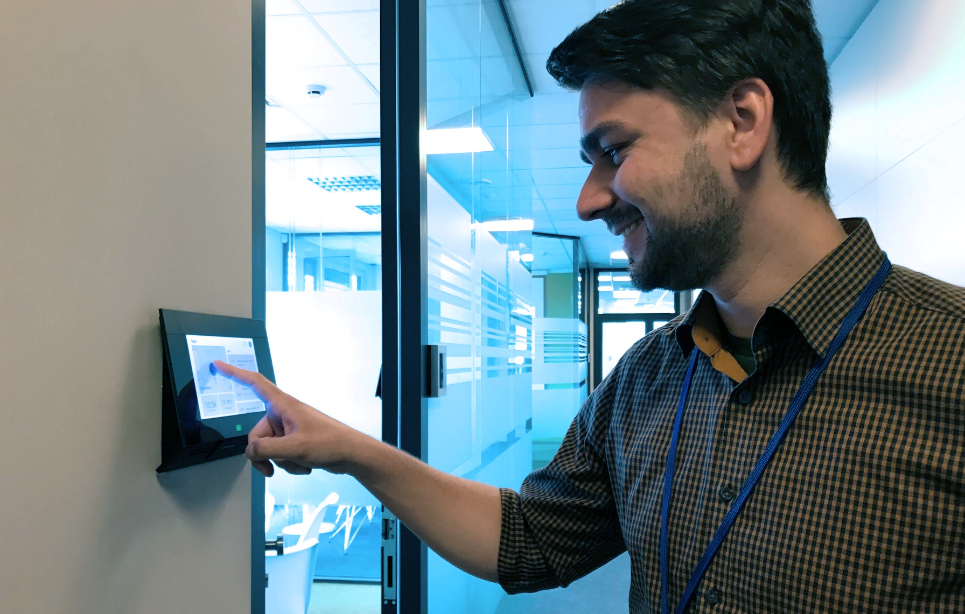
Features increasing the comfort
Ad-hoc reservation of the room
Immediate reservation directly from the panel
Works only if the meeting room is currently empty
Cleaning room feature
Informs facility manager (or receptionist) that the room must be cleaned
Facility manager sees who had a meeting and when the next one is planned

Slide 5
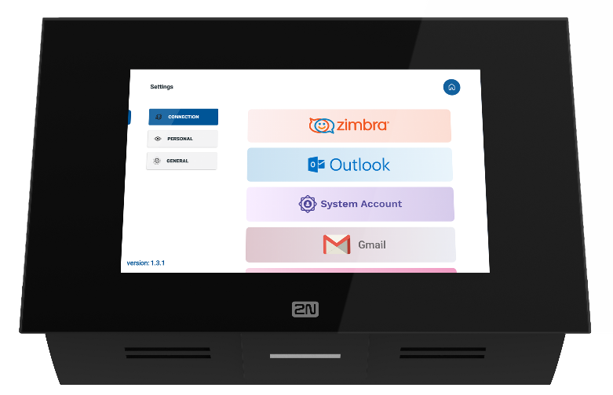
Synchronization with office platforms
2N® Meeting Room supports the automatic synchronization with a wide range of shared calendars and office platforms:
Microsoft Office 365
Microsoft Exchange
Gmail
Zimbra

Slide 6
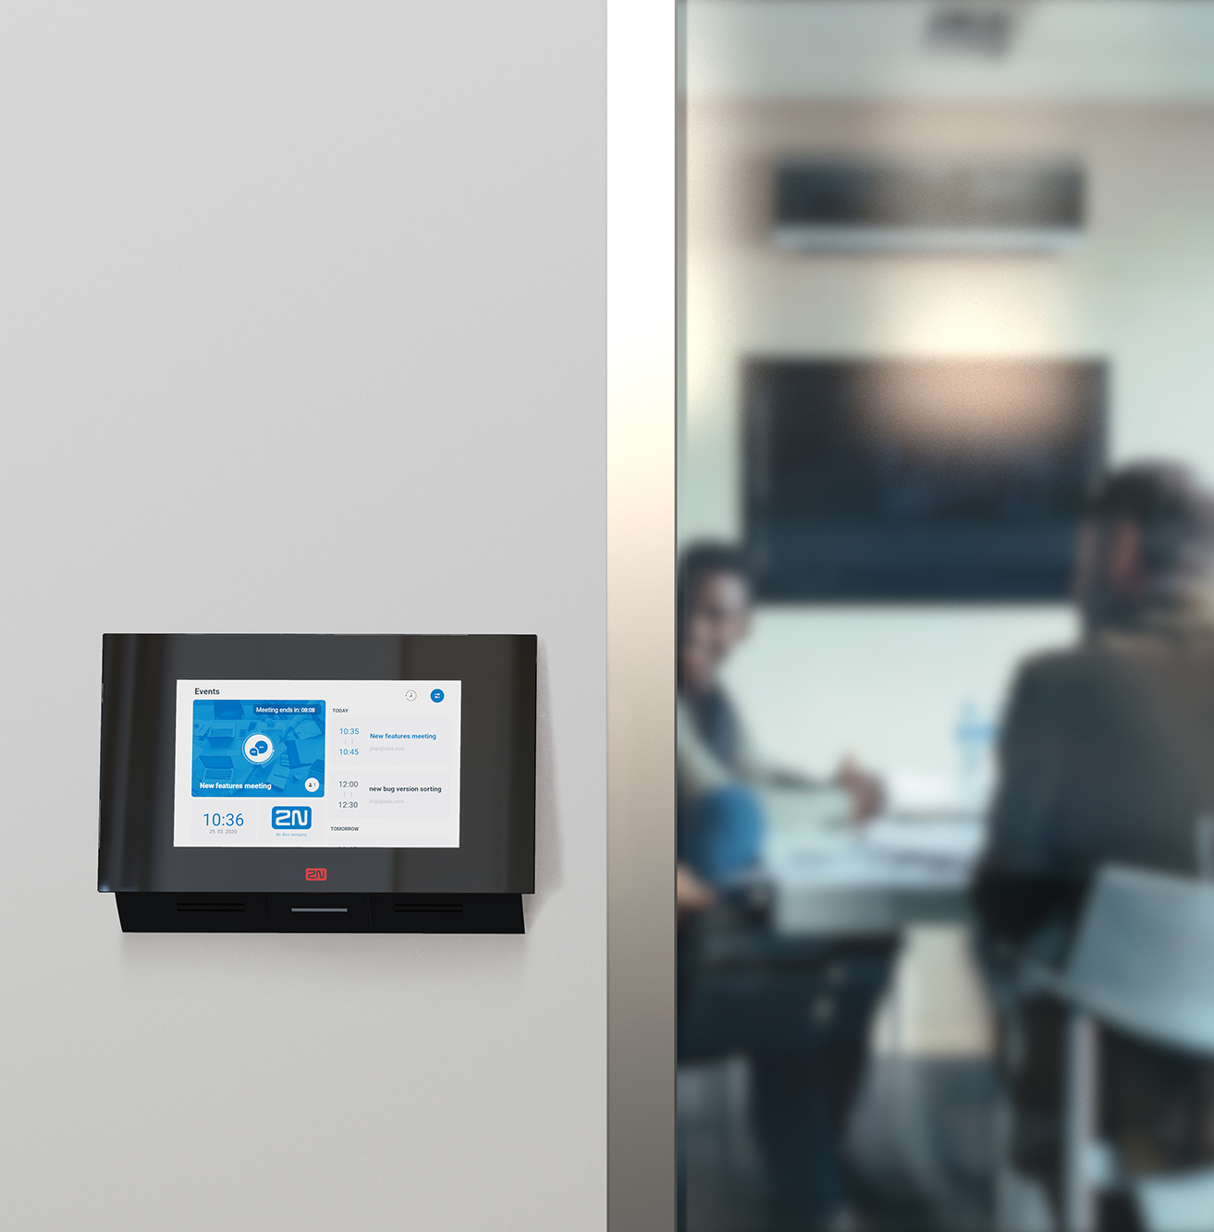
Configuration and installAtion
Configuration right from the panel
Admin’s local presence required
Where to place the panel?
Outside the meeting room
Inside the meeting room

Slide 7
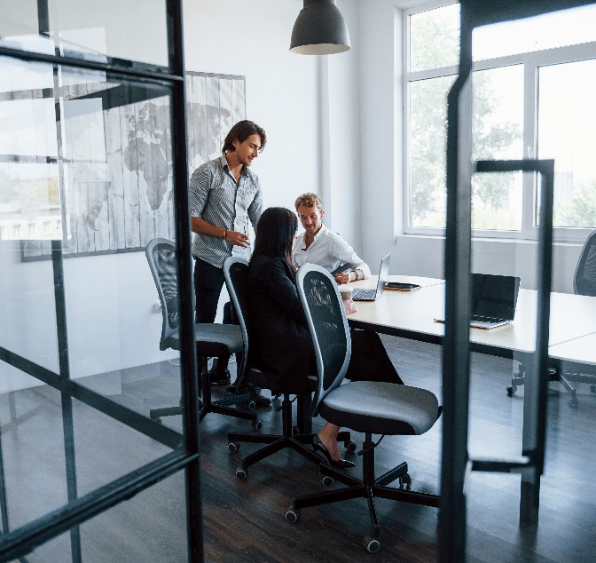
Suitable for …
Meeting rooms
Shared offices
Conference halls

Slide 8
How to run the app?
3 steps to run 2N® Meeting Room app on 2N® Indoor Touch 2.0
Upload the „Meeting room license“ into the 2N® Indoor Touch 2.0 (91378396)
Activate 2N® Meeting Room app (function) in the device*
Install the panel near the door to the meeting room
Synchronize the app with the shared calendar at the company
*To ensure user comfort, the panel itself deactivates all calling features!

Slide 9
Get an overview of the room occupancy with the 2N® Meeting Room app!
Notes:
no longer have to experience the complicated process of finding out which meeting room in their company is currently free

