Slide 1
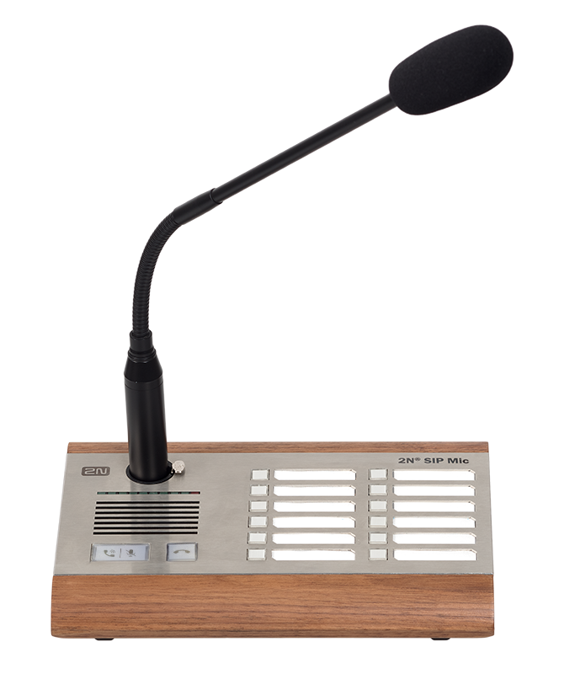
2N® SIP Mic
SIP Based Microphone Console

Slide 2
2N® SIP Mic
VERTICALS
Education
Office
Transportation
Healthcare
Government
Retail

Slide 3
2N® SIP Mic
Server-less paging to up to 12 zones
multicast technology used
paging up to 12 zones
no server needed
console and speakers connected in LAN
Notes:
By using multicast technology and sophisticated controlling mechanisms console enables paging to up to 12 zones by simple push of a button.
There is no server needed for so installation is straight forward only console and speakers connected in LAN.

Slide 4
2N® SIP Mic
Two-way communication
inbuilt speaker
possibility to establish SIP call with
2N IP intercom
console for communication in
security applications
Notes:
SIP protocol was made to communicate and that is what 2N® SIP Mic can do as well. Inbuilt speaker enables users to establish SIP call with 2N IP intercoms and use it as a console for communication in security applications, where simple and powerful interface is needed.

Slide 5
2N® SIP Mic
Pre-recorded announcements
storing pre-recorded messages
replay by push of a button
announcements to designated zones
suitable for sites where the same
messages are needed
Notes:
Installations like shopping malls where a few same messages are played many times. SIP Mic enables to store pre-recorded messages that can be played by simple push of a button to designated zones.

Slide 6
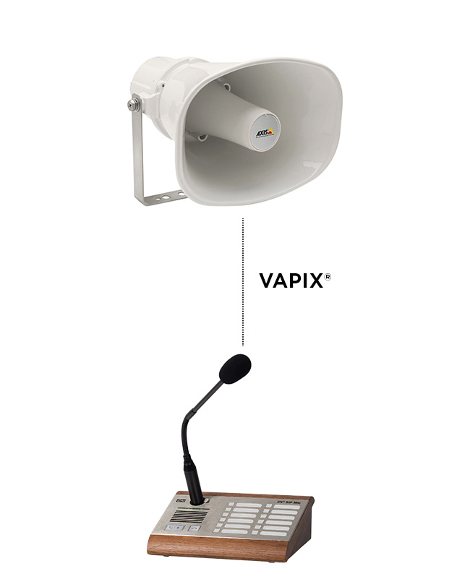
2N® SIP Mic
Integration with Axis
Axis VAPIX® support
paging into Axis cameras and speakers
Notes:
Axis Vapix® Support for paging into Axis cameras and speakers.

Slide 7
2N® SIP Mic
CONNECTION TOPOLOGY

Slide 8
2N® SIP Mic
INTEGRATION WITH 3RD PARTY PRODUCTS
any PBX with SIP 2.0 support
Axis Communications
TELEPHONY
VIDEO MANAGEMENT SYSTEMS

Slide 9
2N® SIP Mic
ACCESSORIES
2N IP Audio Power Supply
914102E/GB/US

Slide 10
2N® SIP Mic
Technical Specification
Audio stream: SIP2.0, RTP multicast, VAPIX®
Audio codecs: G.711u, G.722
Speakers: 2 build-in, stereo, power output 2x1W
Headphone output: 3.5 mm jack, stereo, power output 2x30 mW, min. load impedance of 16 Ohm, DR. 101 dB, THD+N -85 dB
Primary microphone input: symmetric, XLR, integrated phantom power supply 24 V, DR 88 dB, THD+N -82 dB
Power supply: 12 to 32 V, power draw max. 1 A
PoE to 802.3af standard

